Slide 1
Calibration of Bird’s-Eye View Semantic Segmentation
Markus Kängsepp
30.05.2022

Slide 2
Structure
FIERY - semantic segmentation model
Calibration of semantic segmentation
Notes:
This presentation covers 2 bigger topics, 1st FIERY - the semantic segmentation model in Bird’s Eye View and secondly calibration of the outputs of the FIERY model. Let’s start with the FIERY.
Laiem taust minust ja miks see mudel?

Slide 3
FIERY: ICCV 2021
Notes:
The motivation for our work is to get well-calibrated classifiers and to achieve this we need to be able to evaluate calibration as well as possible. Before going into the issues with current most popular way, I will cover some basics.
Täpsemalt firmast ja et Alex Kendall käis ka paari aasta eest esinemas.

Slide 4
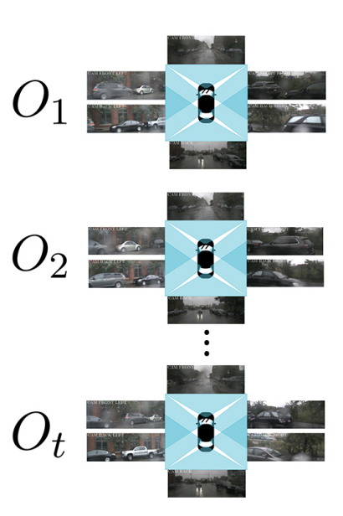
FIERY: Inputs
1
2
t
1
Notes:
There are 6 camera images around the vehicle, which cover 360 degrees area around the vehicle. Moreover the model uses couple of timesteps in past to model motion of the objects.

Slide 5
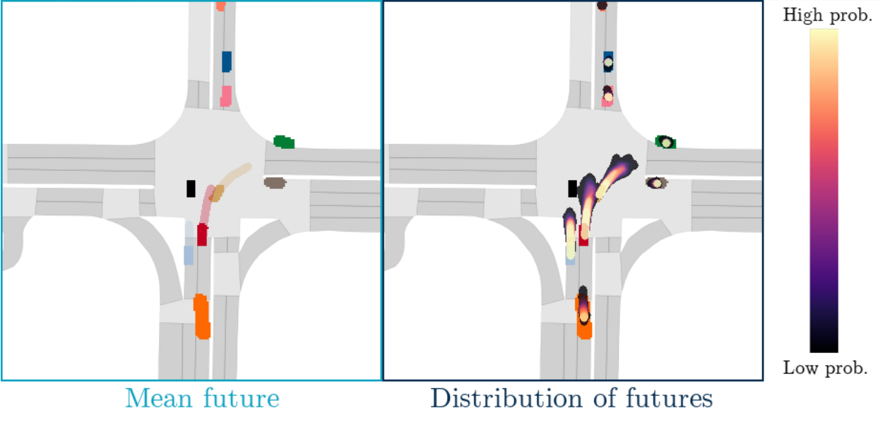
FIERY: Final output
Notes:
The input camera images with the information about relation of these are converted into BEV segmentation - each colored blob is the segmentation of the vehicle. The see-through pattern in front of the segmentation is the “future flow” of the vehicle. (TODO: zoom in and animate). On the left

Slide 6
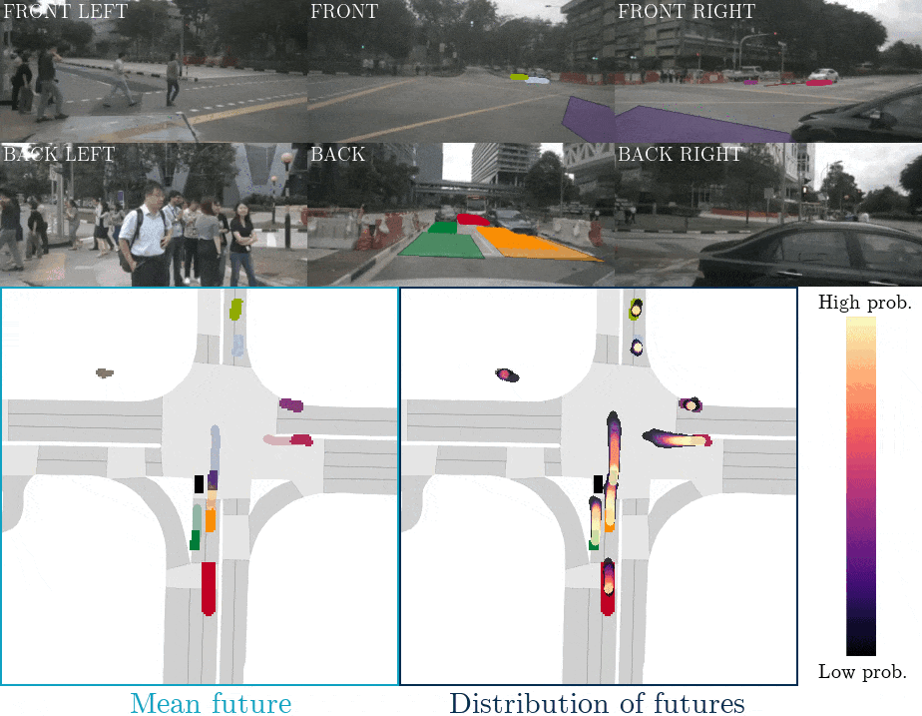
Notes:
Replace GIF with images.

Slide 7
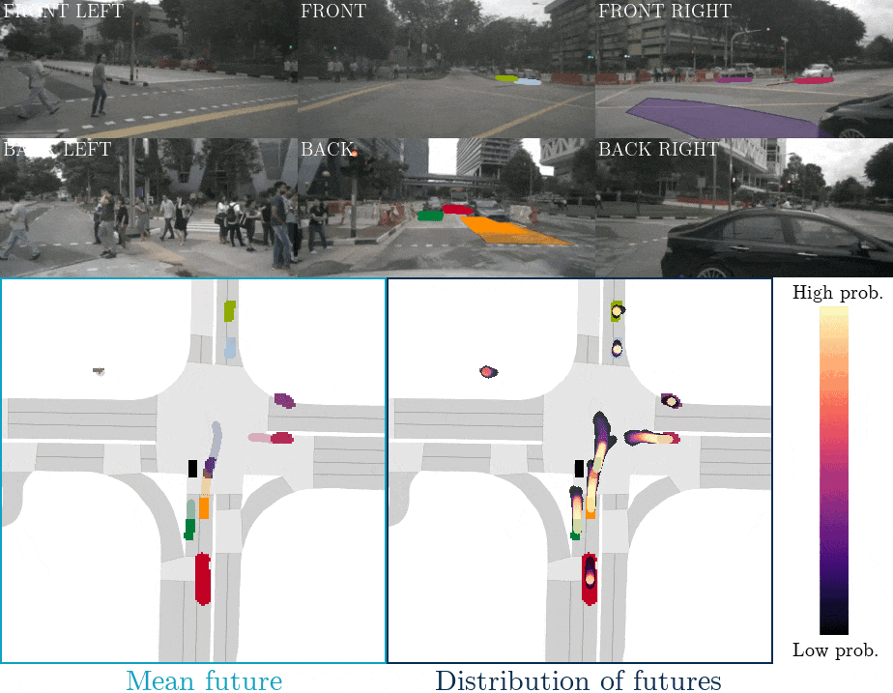

Slide 8
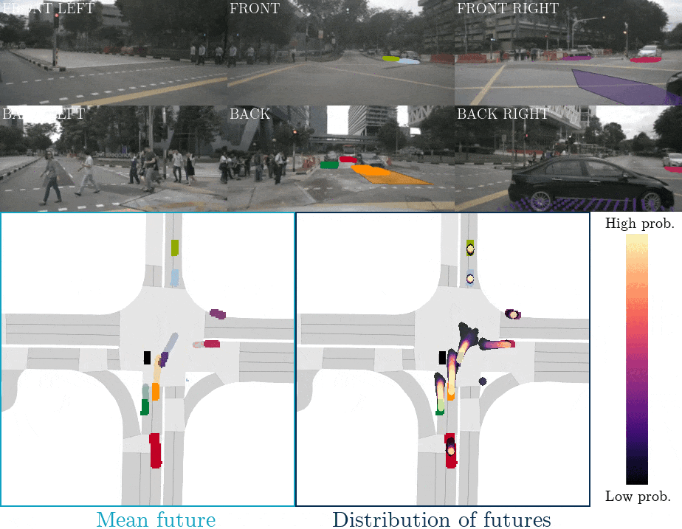

Slide 9
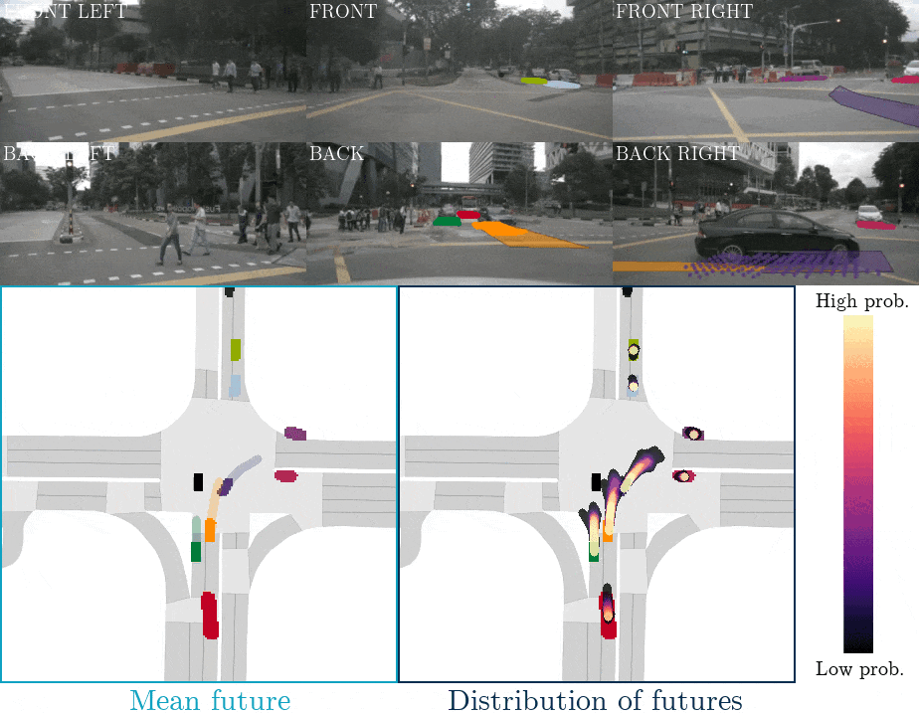

Slide 10
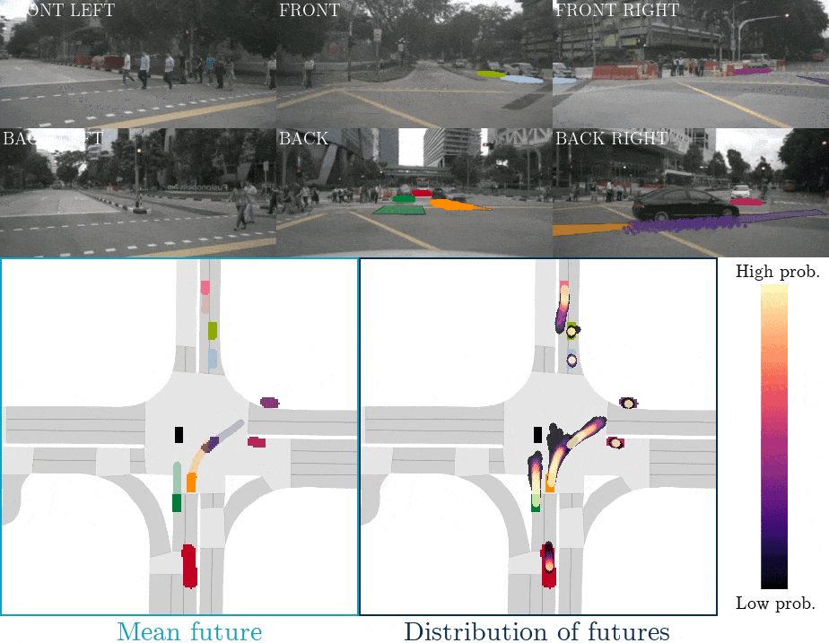

Slide 11
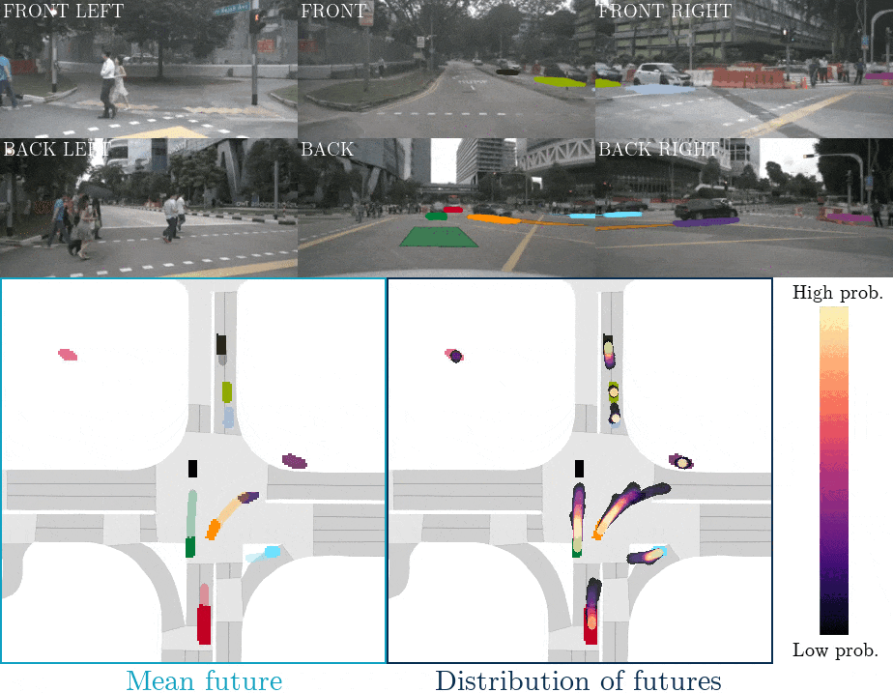

Slide 12
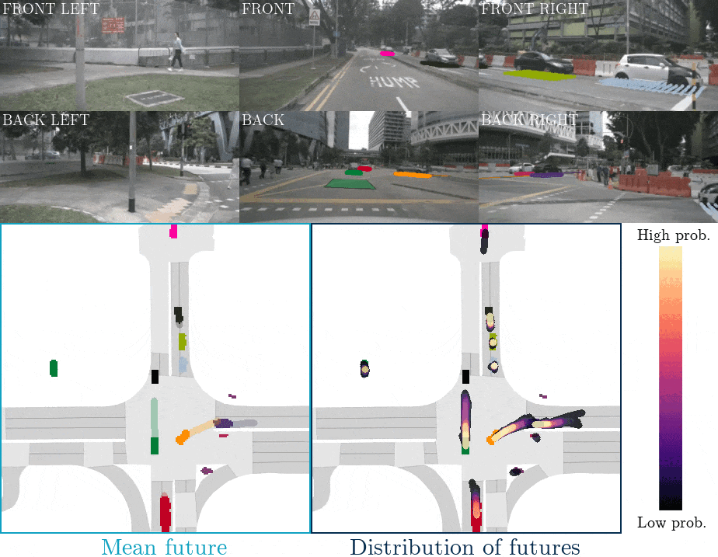

Slide 13
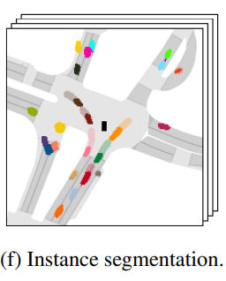
FIERY: Model output
Notes:
Combining the different output heads into one might help with the final output.
Kas nende kohta oli veel midagi?

Slide 14
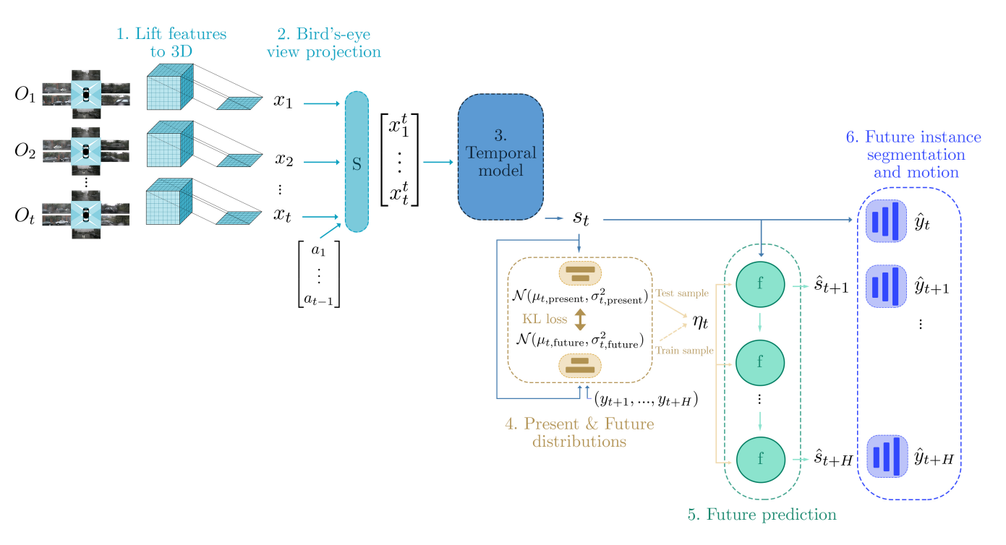
FIERY: Architecture
Notes:
I will go quickly over the architecture of the model. (Zoom in?)
What’s going on in each subsection?
Osade kaupa näidata, katta alumine osa kinni.
zoom ära kaotada

Slide 15
FIERY: Replication and pedestrians
Re-trained the model on vehicles
Trained from scratch on pedestrians

Slide 17
Notes:
Rääkida, et see on see mille põhjal mudel peab ennustama

Slide 18
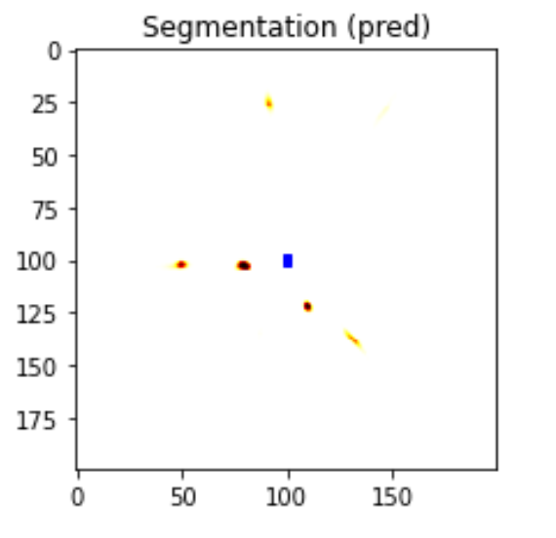
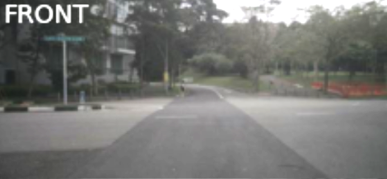
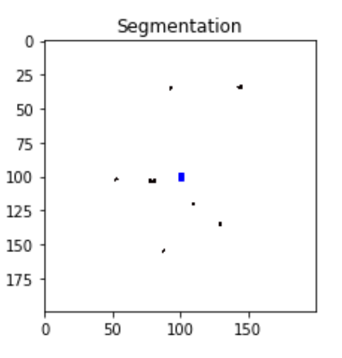
FIERY: Replication and pedestrians
Re-trained the model on vehicles
Trained from scratch on pedestrians
Notes:
As some of you might have noticed these results were only on vehicles, however, it is crucial to model also pedestrian behaviour. (TODO: example output on pedestrians). So if any one of you is interested in using the same model by yourself, I can help with setting up and avoiding some pitfalls, I spent too long on figuring out.
Kuidagi hinnata mudeli headus!!

Slide 19
Motivation
Planning from Bird’s-Eye View (BEV)
Moving vs Static object’s
Cost-map calculation
Might need calibration?
Notes:
This kind of segmentation can be used as an input to planning module, and based on these a cost-map of future actions can be calculated. (TODO cost-map näide)
Näide tuua, et kui kalibreerimata, siis oht suurem objekti märkamata jätmiseks

Slide 20
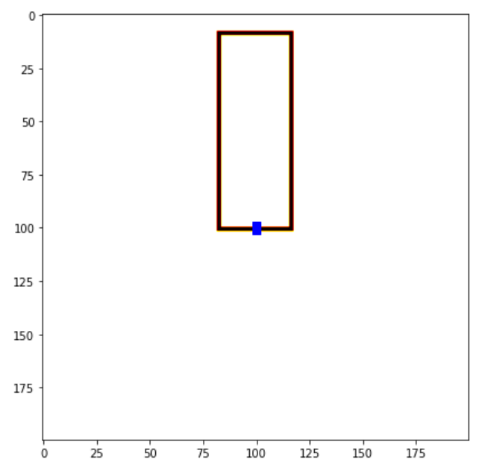
Calibration: Semantic segmentation
Pixel-wise calibration
Area in front of the ego-vehicle
45x16 meters
Notes:
Näide auto ees olevast alast. Segmenteeritud vaade ja pilt.

Slide 21
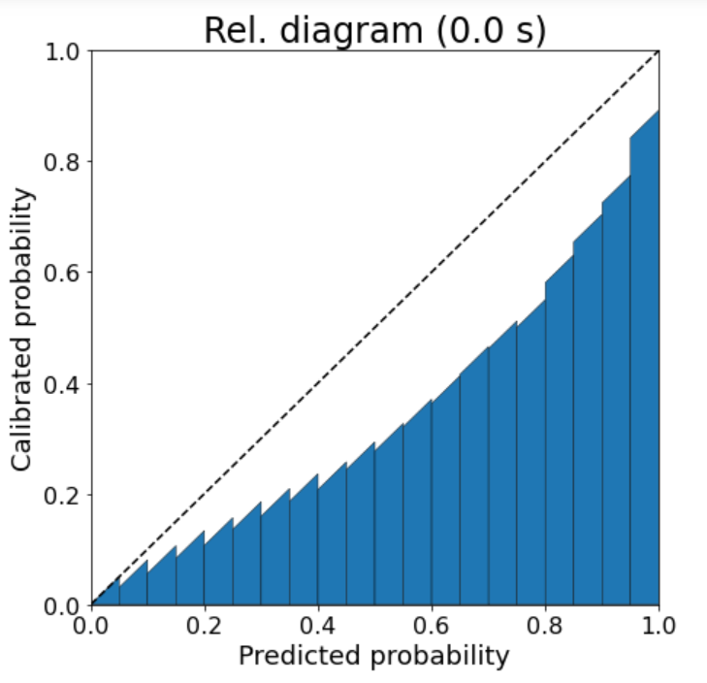
Calibration: Semantic segmentation
Uncalibrated reliability diagram
Over-and under-estimating
Notes:
We use 45 degree tilted bar tops, as it helps with visualization and does not change the results. To check the reasoning, look at my and colleagues previous paper.
Equal-width, equal-size -> log-scale
All most all of the instances in the first bin (11.6 million)
Fonts bigger for figure
Tuua selgelt välja mis igas binnis on
Siin rääkida ECE, calibrated (probability)
- > High-light some bin
over and under-estimating probability of pedestrian

Slide 22
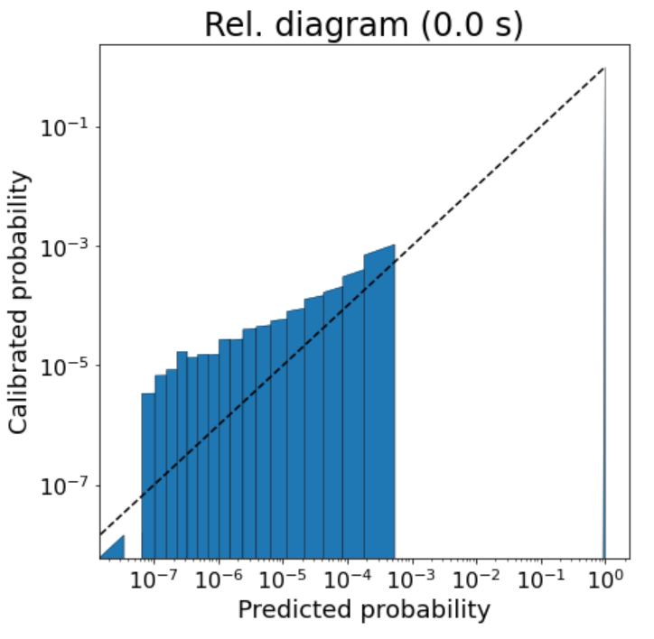
Calibration: Semantic segmentation
Log-scale reliability diagram
Under-estimation of probability
Notes:
Equal-width, equal-size -> log-scale
Underestimation of probabilities, can be bad. Example where model missed a person. 1 out of 10000
Es ja EW mainimata jätta

Slide 23
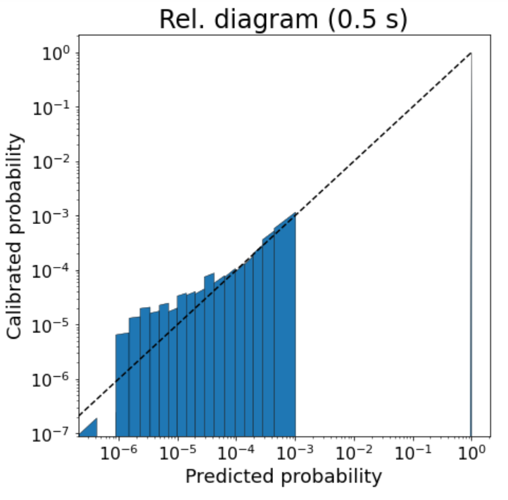
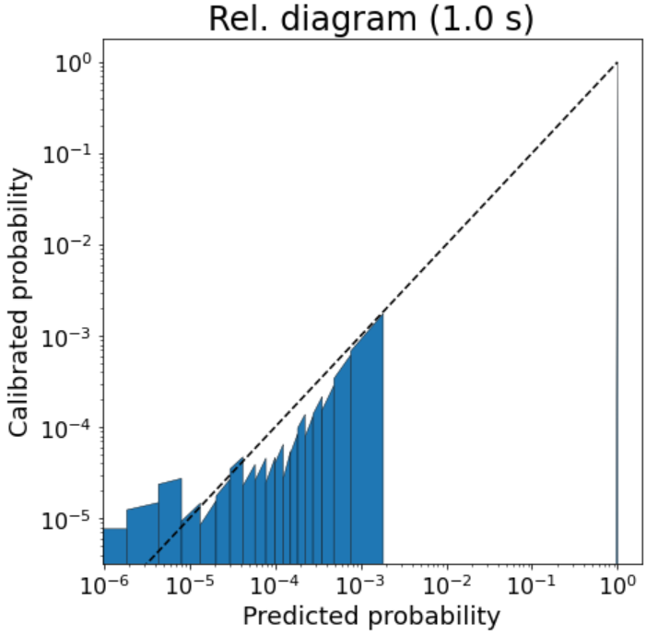
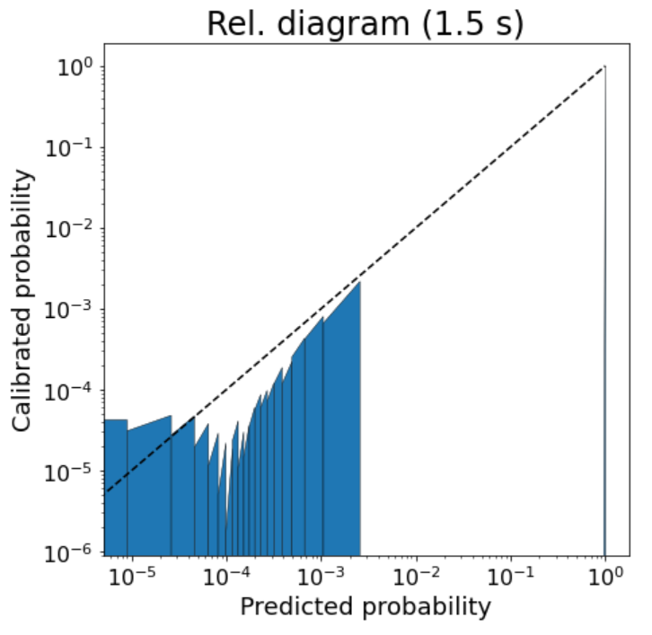
Calibration: Semantic segmentation
Future predictions
Notes:
0.5s , 1.0s ja 1.5s

Slide 24
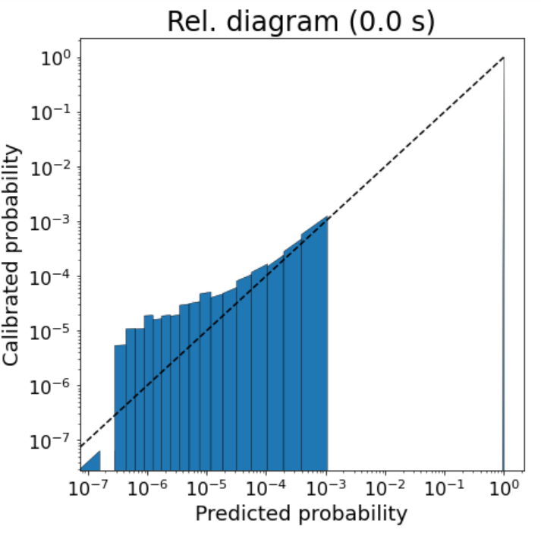
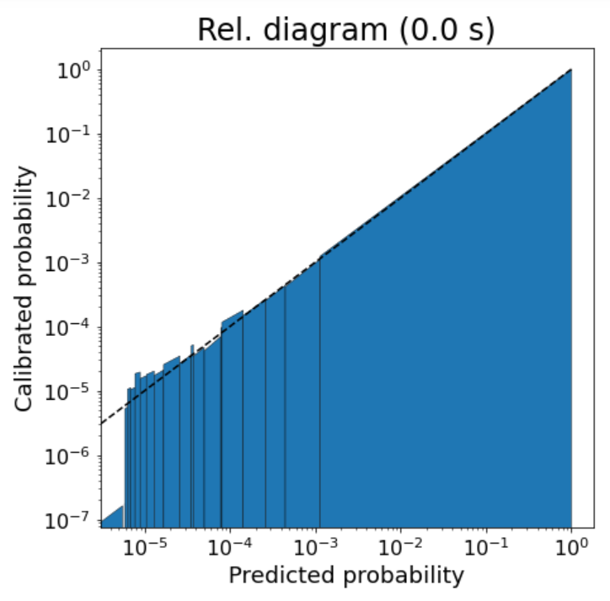
Calibration: Semantic segmentation
Uncalibrated
Temp-Scaling
Isotonic
ECE: 8.4*10⁻⁴ 6.5*10⁻⁴ 3.2*10⁻⁵
NLL: 5.63*10⁻³ 5.54*10⁻³ 5.30*10⁻³
Notes:
Comparison of results in table (NLL, ECE, AUC) vs different calibration methods
Siia ECE/NLL

Slide 25
Conclusion
FIERY is great semantic segmentation model
NOT pixel-wise calibrated
Isotonic regression is best at calibration
Object-wise and region-wise calibration yet to be done.

Slide 26
Thanks for listening!
Projects: ETAg PRG1604 and Bolt LLTAT21278
Notes:
stipid siia
CS logo

