Slide 1
Data science & machine learning in our company
Kaupo Voormansik
30.05.2022 Tartu

Slide 2
Outline
Quick intro of KappaZeta.
Machine learning & data science in KZ.
KappaOne.
KappaMask.
Let’s build a data factory for global elevation data.
Green deal, Earth Observation data science and thesis options with KZ.
Notes:
Julgustan küsimusi vahele küsima, kohe kui on mingi uus mõiste või asi, millest aru ei saa.

Slide 3
KappaZeta
EO services company.
Established in 2015 (economically active since 2017).
Spin-off of Tartu Observatory, University of Tartu.
SAR and deep learning technology.
Applications in agriculture sector.
Analysis ready S1 data layers for other EO and ICT companies

Slide 4
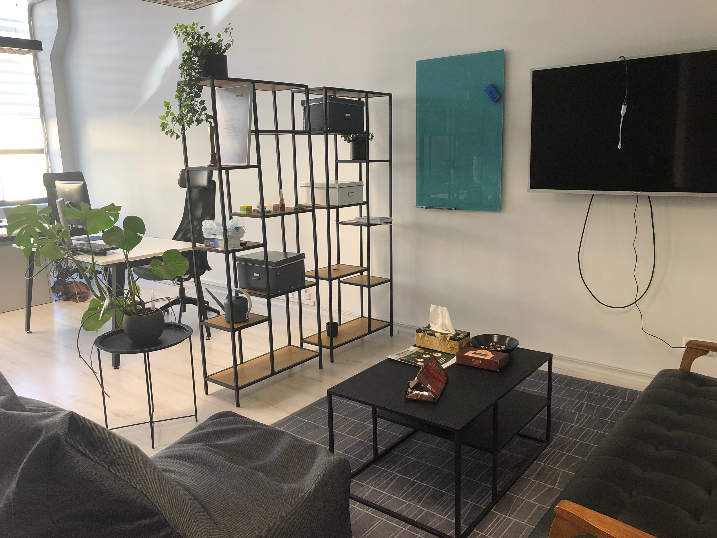
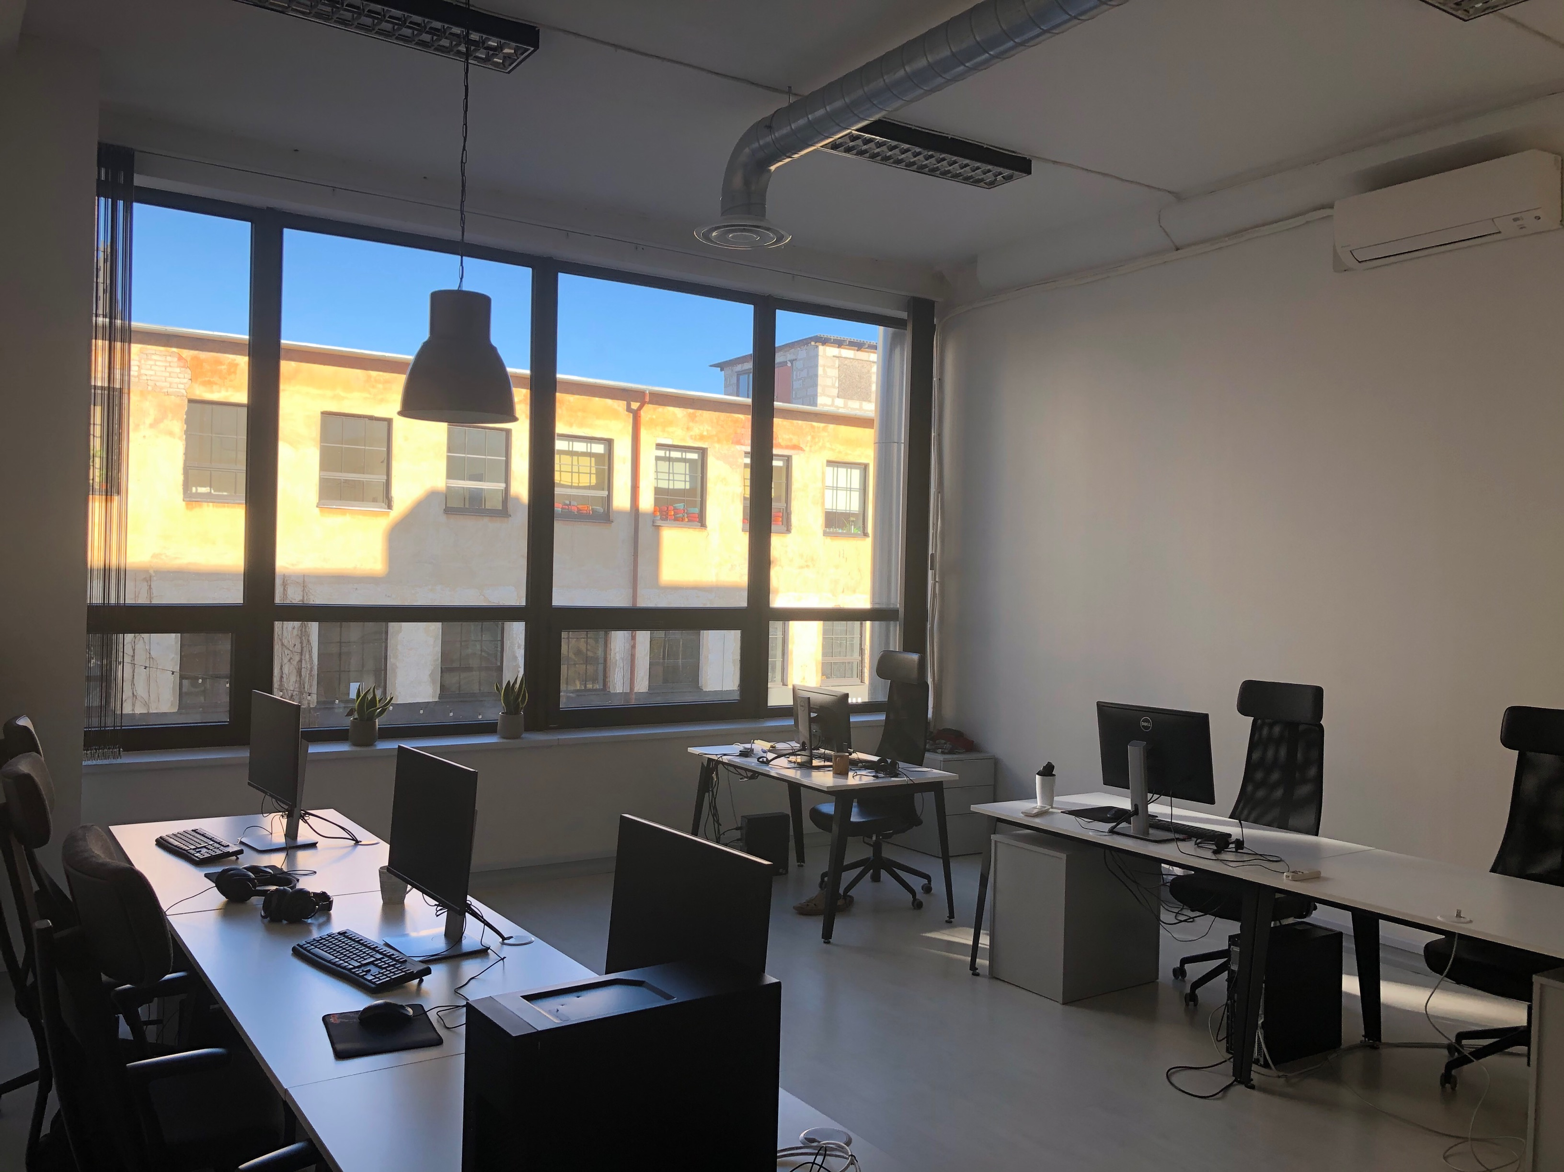
KappaZeta today
Team of 14+5 and growing.
Offices in Tartu (Aparaaditehas) and Kuressaare.

Slide 5
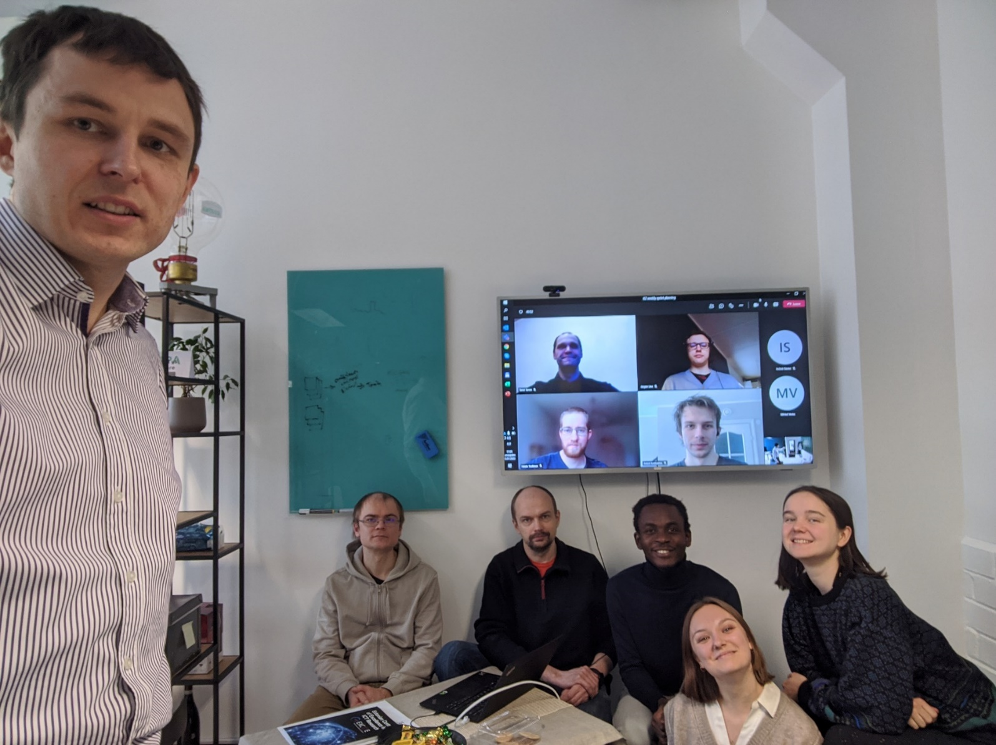
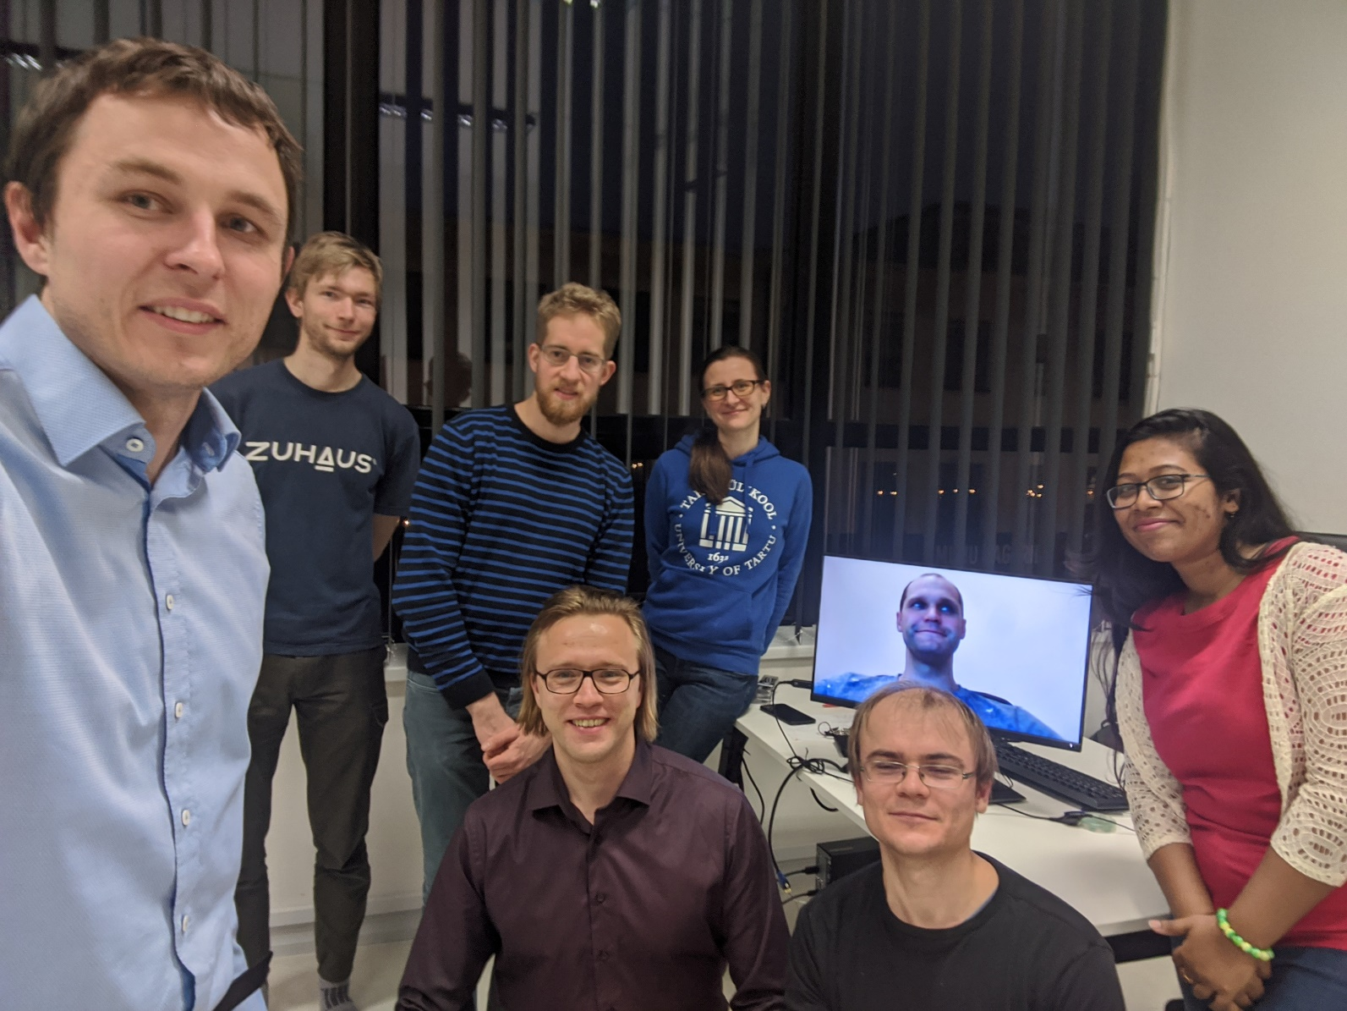
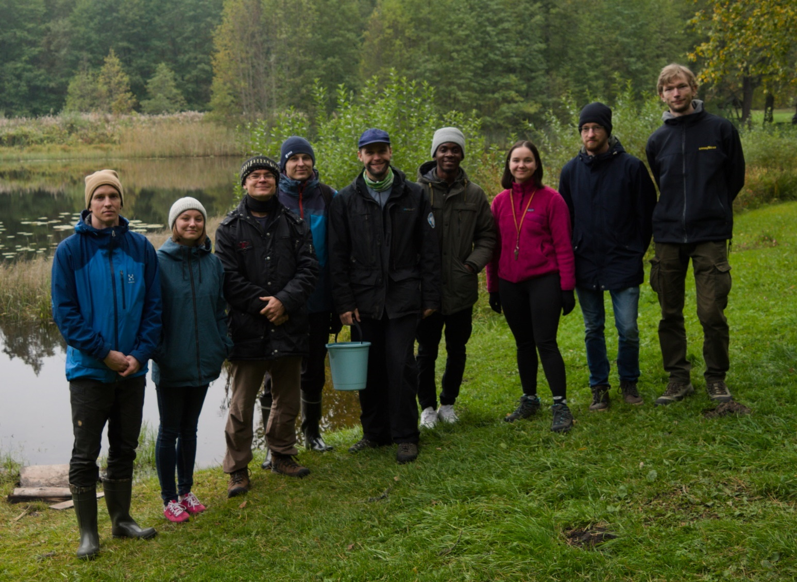
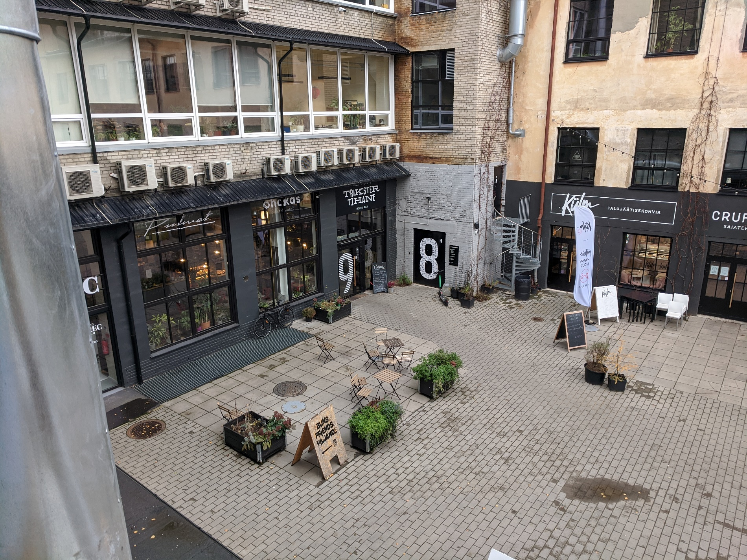
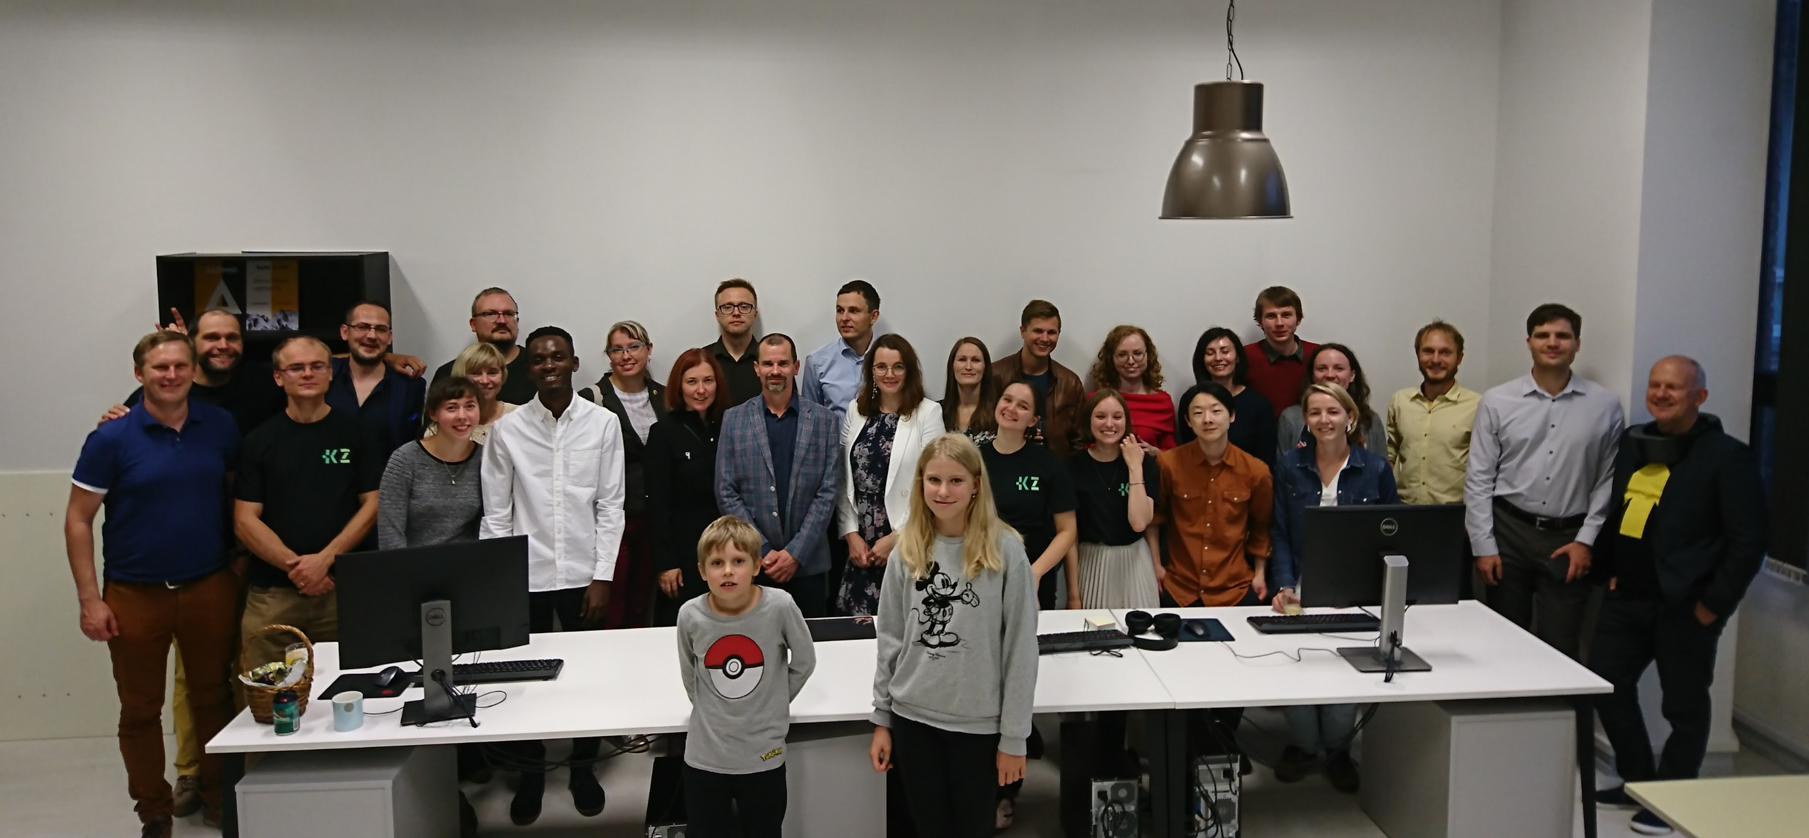
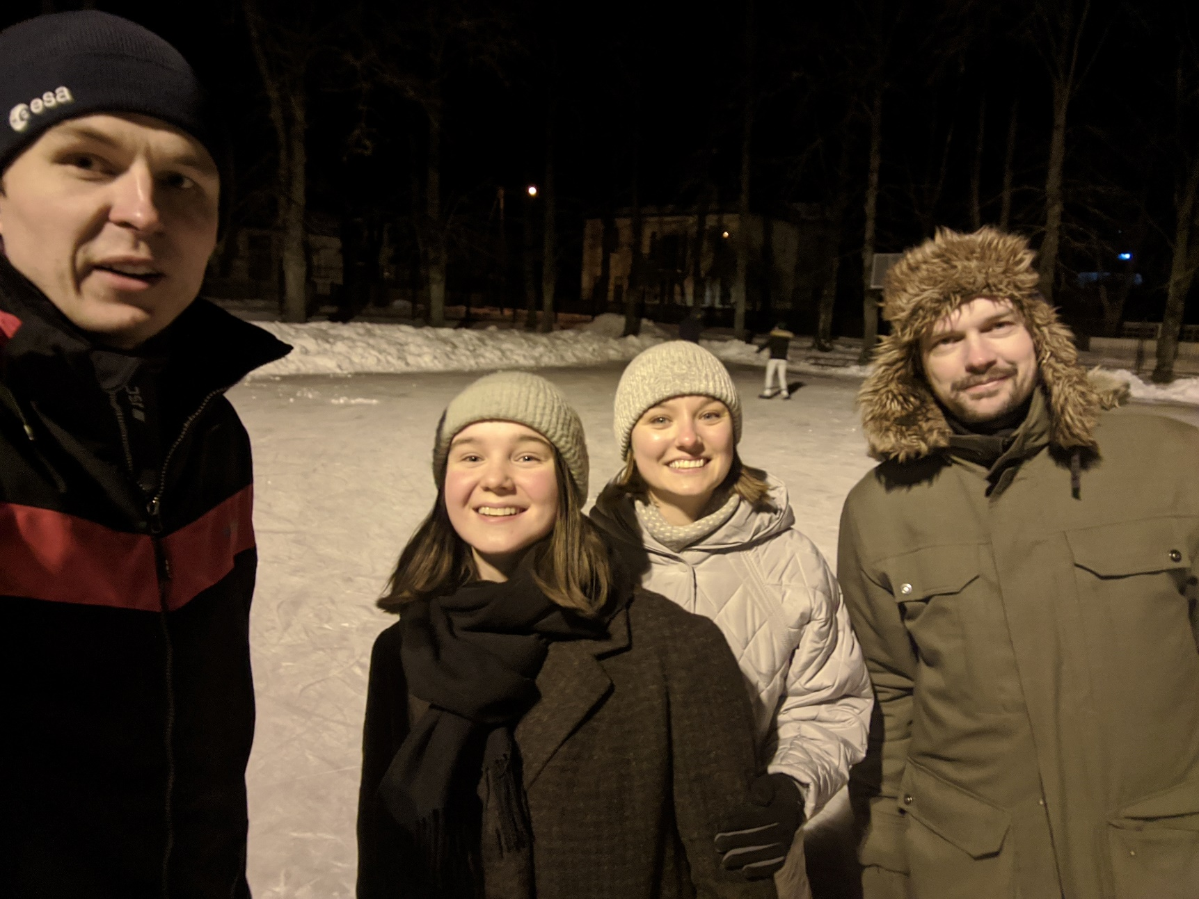
Notes:
Ütlen välja, et kõige rohkem on praegu vaja KappaZeta-sse äriarendust teha oskavat inimest. Kui meie tegevusvaldkond pakub huvi, siis palun tule ja otsi meid üles, räägi milles sa hea oled ja võib-olla alustame koostööd.

Slide 6
Main applications of KappaZeta
KappaOne Sentinel-1 (and other SAR) analysis ready data layers to other EO and ICT companies as an API and WMS/WCS services.
Agricultural information services to farmers and agri-insurance.
Satellite monitoring for European Paying Agencies (PRIA and others).

Slide 7
KappaOne S1 ARD layers (InCubed)
Agri-Insurance applications
Monitoring services for PAs
Insurance companies /
Farmers

Slide 8
Increasing importance of food and agriculture
Source: https://www.pinterest.com/pin/552253973038383581/?lp=true

Slide 9
Machine learning & data science in KZ
In virtually everything we do.
A set of useful tools that we have adapted (…and continue following the latest developments).
Machine-learning model (if correctly set-up) is in 99% of cases superior to the “old school” manual models.

Slide 10
Machine learning & data science in KZ
Examples:
KappaMask – cloud mask for Sentinel-2 imagery.
Various agricultural models for paying agencies and agri-insurance (crop classification, farming event detection, damage assessment).
Value added AI-modelled data layers in KappaOne (S1 and S2 modelled biomass, S1 image with S2 image look).

Slide 11
KappaOne
Sentinel-1 SAR imagery made easy to use – the freshest satellite image with global coverage.
KappaOne – ideally one click (or one API command) integration and use.
“Professional” calibration, thermal noise correction and speckle suppression.

Slide 12
KappaOne
Webmap.
WMS/WCS rasters to your desktop or web GIS.
Query the time periods, areas and layers you need over API.

Slide 13
KappaOne
Try it out! ☺
https://kappaone.eu/ard_landing/

Slide 14
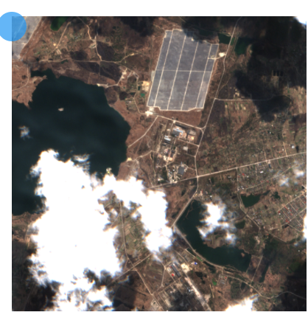
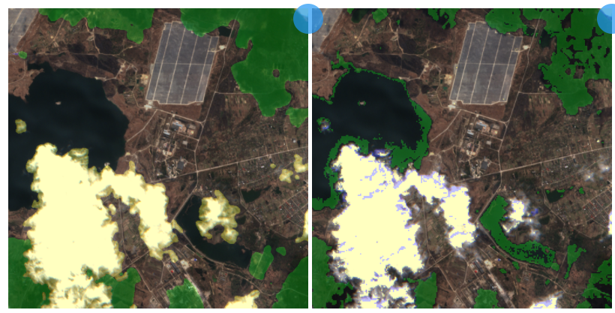
KappaMask - visual comparison with Sen2cor
Sen2cor (rule based, current ESA default mask)
Sentinel-2 image
KappaMask (AI)
Water misclassified as cloud shadow
Small fragmented clouds undetected
Legend:
Yellow – cloud Green – cloud shadow
See more at: https://kappazeta.ee/cloudcomparison

Slide 15
OK, but what if we’d build a high impact Earth Observation satellite?
Adding elevation data to Sentinel-1 with a passive bistatic receiver satellite.
From the crazy ideas, but nothing seems to stop us.
Most of Estonian space community is behind it, including several former ESTCube-1 team members.
Digital surface model derived from DLR TanDEM-X, providing 3D image of the Earth with terrain info and vegetation height. The proposed mission would produce similar data systematically several times per week on a global scale.

Slide 16
Making Sentinel-1 data 3D with a formation flying bistatic SAR passive receiver satellite – future food for the AI, improving the digital twin of Earth
“Doubling” the value of Sentinel-1 data with just a fraction of additional investment.
Focus on operational mission and creating a global data factory.
The need: - huge errors in carbon crediting market; - digital twin of Earth difficult to imagine without 3D and height dimension. - from oil-based economy to bio-based economy, resource data needed!
Recent feedback from ESA Living Planet Symposium is very positive.
Related missions to learn from: NASA SRTM, DLR TanDEM-X and ESA Harmony.

Slide 17
Green deal, Earth Observation data science and thesis options with KZ
Earth Observation and understanding our planet deserves at least 10x attention of the talent than it receives today.
Optimizing the transport of people and food by further 5% is not the greatest challenge of our time.
There is no planet B.
More long-term thinking needed from the investors and government!

Slide 18
Green deal, Earth Observation data science and thesis options with KZ
Possibility to do data science theses with KZ team.
https://comserv.cs.ut.ee/ati_thesis_offers/?language=en
Topics:
AI-based speckle suppression for SAR data.
Detecting crop growth phases from Earth Observation data.
Image to image transition models for Earth Observation data.
Modelling green-house gas emission and sinks using Earth Observation data.
Come to talk with us. :-)

Slide 19
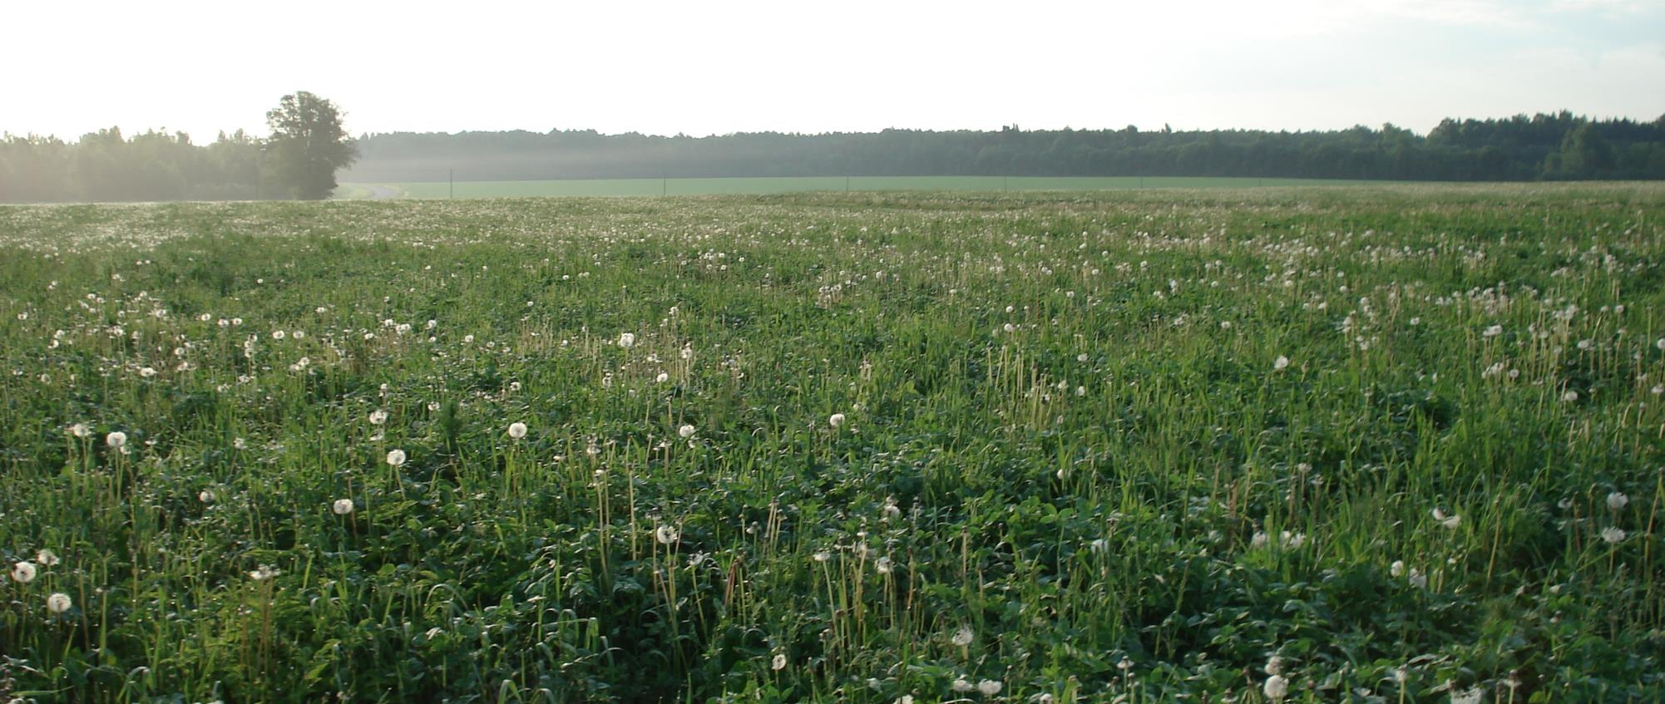
Aitäh!
kaupo.voormansik@kappazeta.ee
+372 56 669 225
WWW.KAPPAZETA.EE

Slide 20
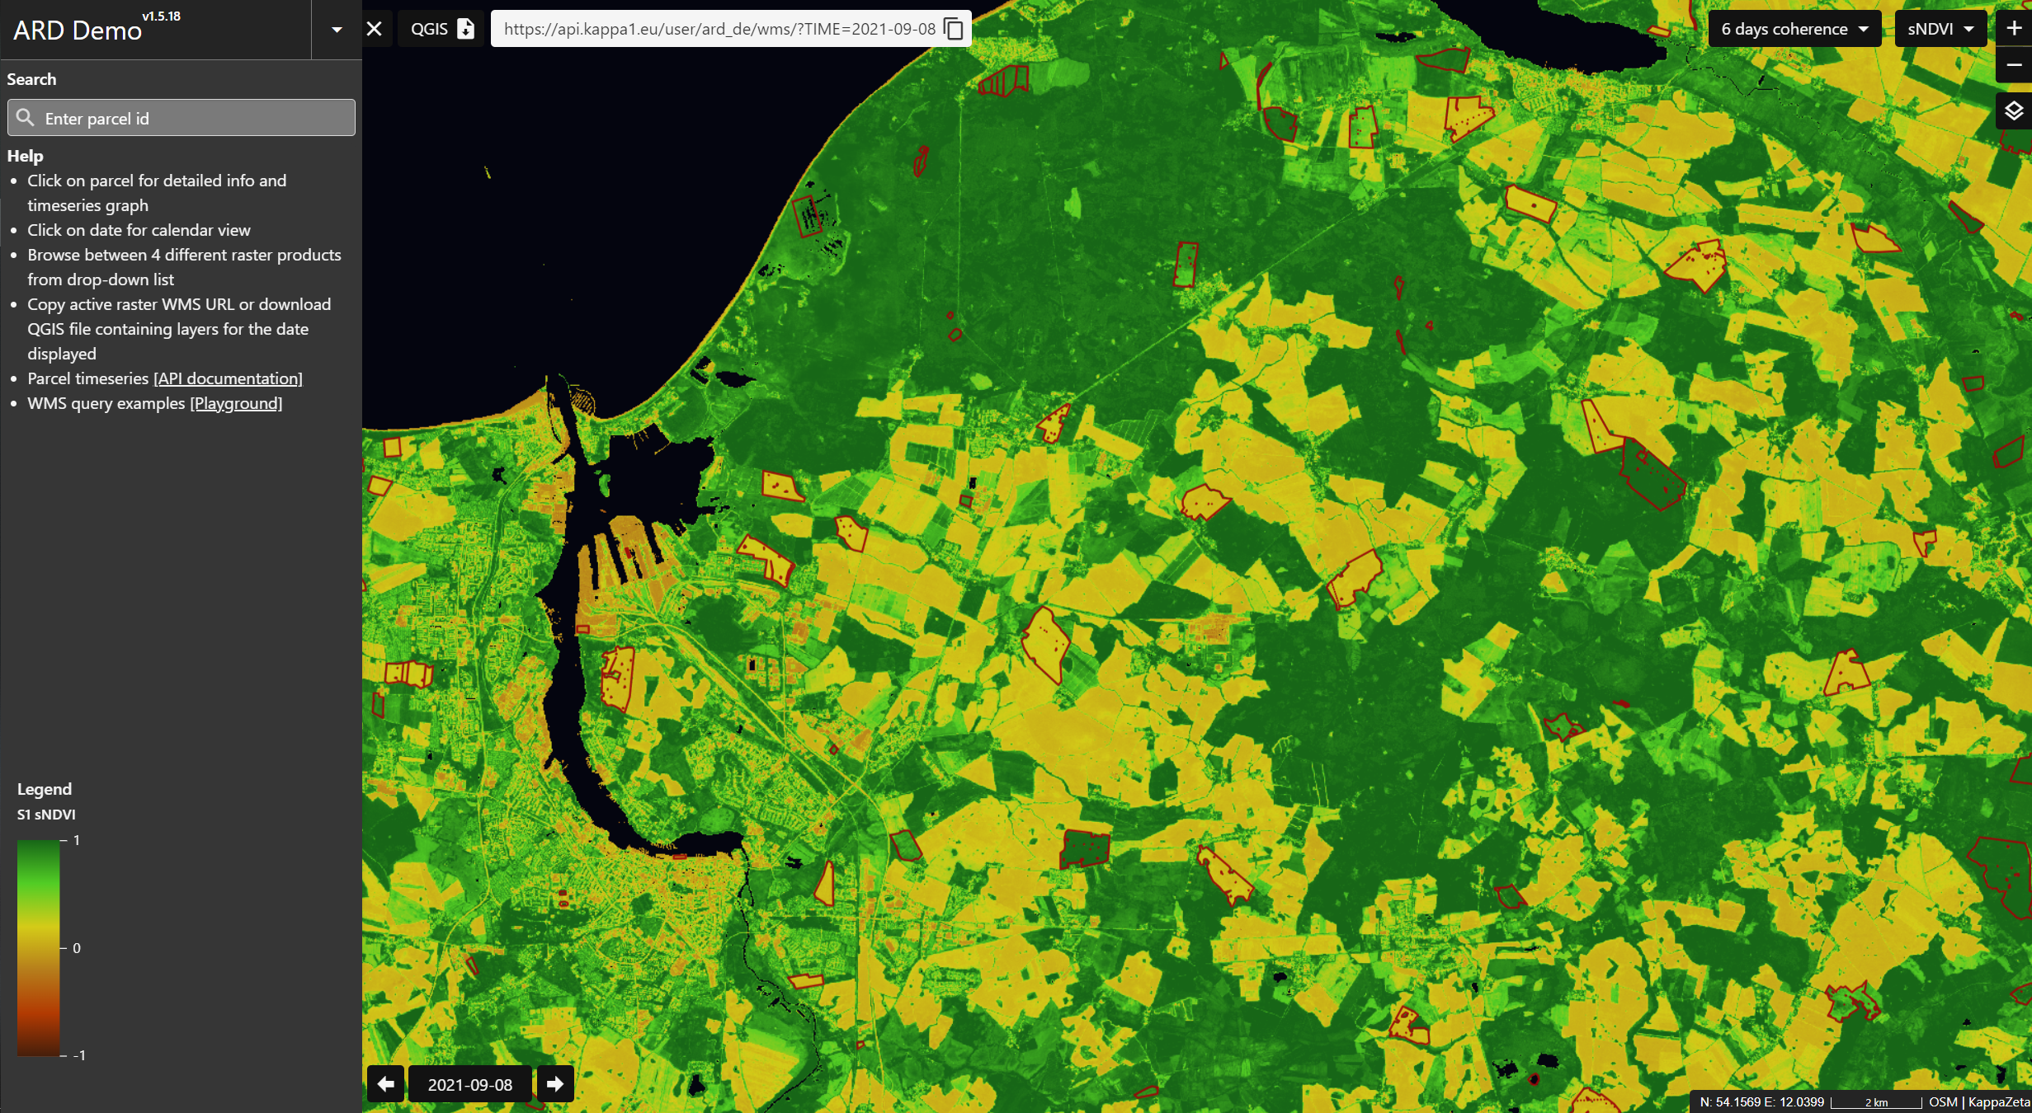
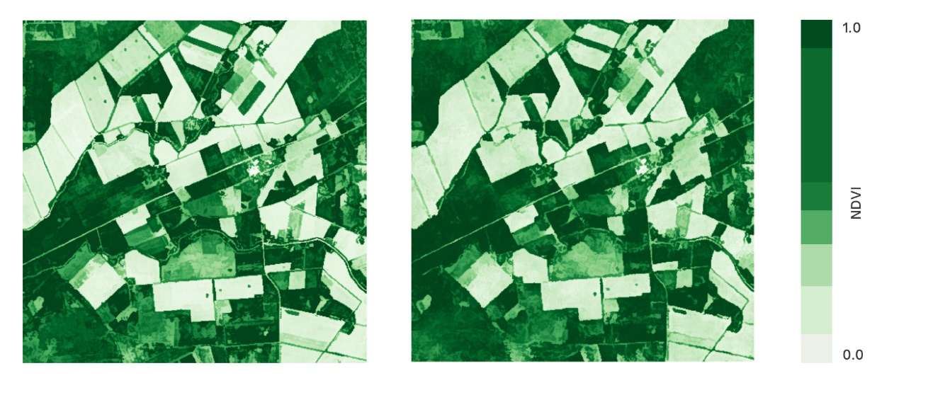
Examples of KappaOne analysis ready data layers
Radar based biomass estimate
Sentinel-1 WMS
Notes:
Et see on praegu arenduses olev kuum teema. Teha Sentinel-1 tuletatud andmekihtide kasutamine hästi lihtne. Klientideks on teised ettevõtted ja riigiasutused, B2B ja B2G teemad. Oleme eksportinud oma teenuseid Saksamaale, Soome ja Iirimaale.

