Slide 1
Towards federation of cross-border sensitive data access and processing
Abdulrahman Azab
Senior Advisor, Nordic e-Infrastructure Collaboration
Data Science Seminar, University of Tartu
October 6th 2022

Slide 2
NeIC projects scope
Archiving / repositories
Processing platforms / Workflows
AAI
ELSI
Use case programme

Slide 3
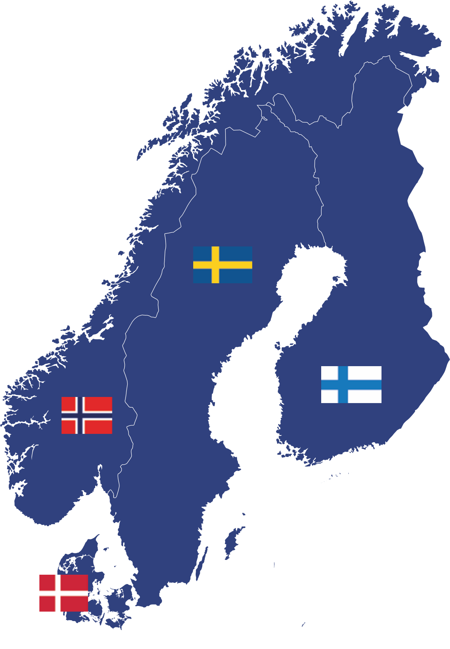
The Nordics have unique digital health registers, biobanks, genome and other data collections

Slide 4
Secure computing and data environments
Nordic service development relies on secure computing and data environments by the nordic e-Infrastructure providers
Secure cloud (IaaS)
Infrastructure for data and computing (ePouta, Computerome)
Secure remote desktop (PaaS)
Backed up with computing resources (TSD, Computerome, Bianca,
CSC ePouta)
Bianca service at SNIC
Sensitive data services CSC
TSD 2.0 service at USIT
Computerome at DTU

Slide 5
Ethical, Legal, and social implications barrier

Slide 6
Tryggve ELSI aspects of current use cases
Based on the analysis of Tryggve use cases certain commonalities regarding ELSI topics can be found, mainly the following:
Possible specific requirements of consents towards data processing.
Determining the data controller
Uncertainties regarding the legal basis for data processing.
Data processor contracts with sub-processors.
Influence of local non-GDPR legislation.
Terms for accessing and moving register data (esp. from Denmark).
Summary document
Fed into work on a checklist

Slide 7
Tryggve Training event for Nordic researchers on ELSI topics
“Tryggve workshop on Implications of GDPR in cross-border research in the Nordics”
Helsinki, April 2019
Applying the GDPR in Nordic research projects
BBMRI Guidelines and Code of Conduct for health research
GDPR issues for cross-border projects - Checklist

Slide 8
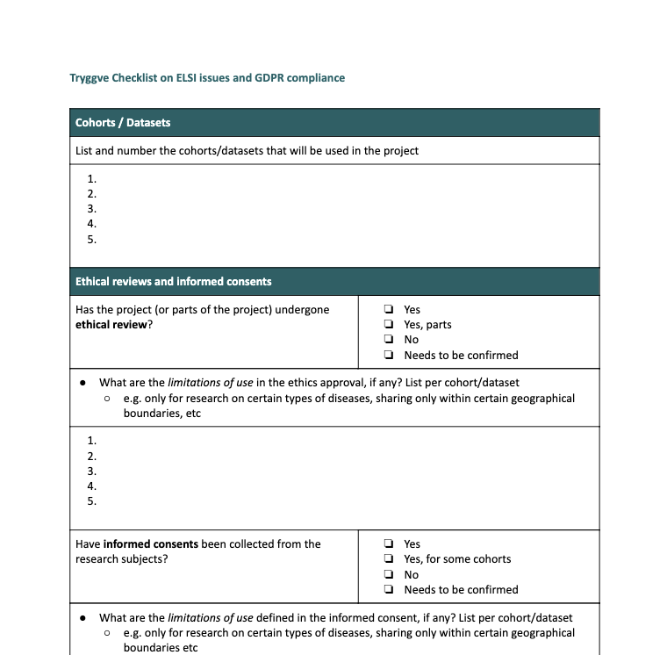
Tryggve ELSI “Checklist”
ELSI issues & GDPR compliance
Ethical reviews & Informed consents
Controllers
Legal basis
Data processing agreements
Data Protection Impact Assessments
Data sharing
Other legal considerations
https://docs.google.com/document/d/1Kg_lrKc0KJVCvMw4iyEhrRslIenEjbjKkWbZ1aK5J68/edit

Slide 9
Managing use cases
Initial contact
Proposal
1. Inquiry
SG
2. Evaluation
SG
3. Preparation
SG
4. Implementation
SG
5. Concluded
SG
6. Retracted
SG
= Steering group decision (email or meeting)
SG
= Inform Steering Group
SG
= Main national Steering Group member consulted

Slide 10
Federated Access

Slide 11
Federated access to sensitive data

Slide 12
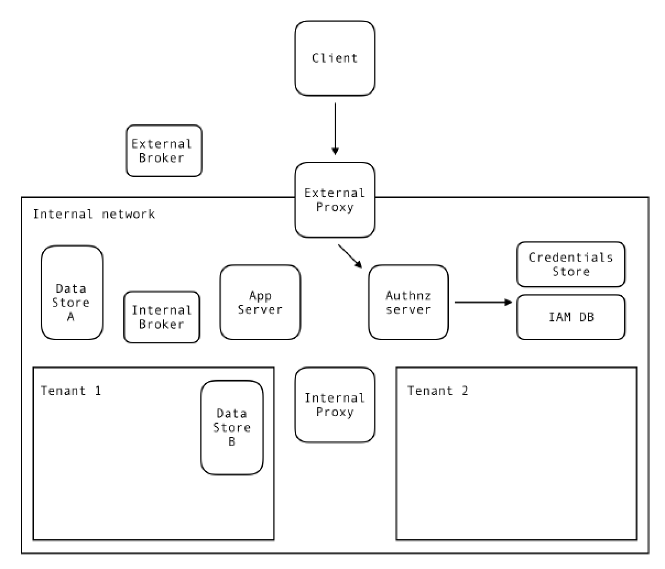
Secure APi for EINfrastructures (SAPEIN)

Slide 13
Federated compute

Slide 14
e-Infrastructure Federation architecture
Application
Layer
Orchestration
Layer
Resource
Layer
Fabric
Layer
Applications, Portals, Environments
Orchestrators, APIs, Protocols
APIs, Protocols, SDKs
Computers, Networks, Devices

Slide 15
GA4GH Compatible Platform (Functional Architecture)

Slide 16
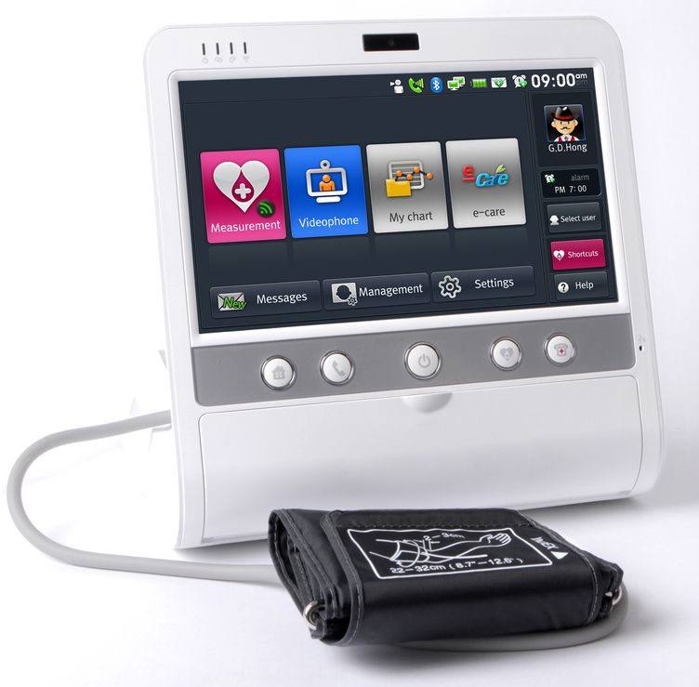
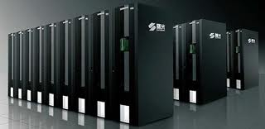
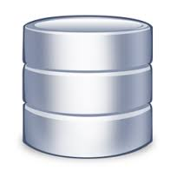
Nordic sensitive data e-Infrastructure federation – GA4GH compliant
Portals/clients
Application layer
Orchestration layer
Broker
Broker
Broker
Broker
Workload management
WES/TES: Secure APi for EINfrastructures (SAPEIN)
Resource layer
Data management
DRS: dCache/RDSDS
Fabric layer
Cloud
HPC
Computerome
(DK)
Cloud
HPC
object
storage
Cloud
HPC
storage
Bianca (SE)
Cloud
HPC
ePouta (FI)
storage
TSD (NO)
storage
TRS: Container Repo
Tool mobility

Slide 17
DK - Federated national infrastructure
The overall objective for the shared national infrastructure
CORE TASKS AND RESPONSIBILITIES
Example repo’s
1
Central repositories
Content, quality, development of the National Genome Database
Raw data
Patient and variant database
2
Completion of analyses
Development and maintenance of analysis environment
3
Shared national secure cloud infrastructure
Establishment of the secure cloud infrastructure for interconnecting HPC-facilities
1
Metadata
4
Technical infrastructure central repositories
Software development and technical infrastructure for the National Genome Database
SEQUENCING EQUIPMENT
Pipeline archive
Database for interpretation
SEQUENCING EQUIPMENT
SEQUENCING EQUIPMENT
Standardised environment for the completion of clinical analyses, and more flexible environments for research analyses
NATIONAL PM CONTROL COMPONENT (SECURE CLOUD)
3
Etc.
Pipeline
Data
Specific applica.
AD software
Virtual CPU
HPC N
HPC N
HPC N
Data platform
Etc.
Pipeline
Data
Specific applica.
AD software
Virtual CPU
LOCAL CONTROL
LOCAL CONTROL
LOCAL CONTROL
Etc.
Pipeline
Data
Specific applica.
AD software
Virtual CPU
2
LOCAL QUEUE SYSTEM
LOCAL QUEUE SYSTEM
LOCAL QUEUE SYSTEM
4
…
…
…

Slide 18
Broker
Investigating: ARC/UNICORE

Slide 19
ARC middleware (NeIC NT1)
Middleware to enable computing grids
Motivated by the needs of LHC experiments
Main goal: common interface to disparate computing facilities
First public preview in 2002, first formal release in 2004
Developed by NorduGrid since 2001
Designed with a distributed Nordic Tier1 in mind
Optimised for HPC deployment
Built-in data caching
Open Source, mostly volunteer contributors

Slide 20
Key components
ARC CE – a Compute Element, providing interfaces to computing resources
Modular, consists of several sub-components (services and utilities)
Interface for job control
Interface for exposing resource and job status info
Data staging and shared cache management utilities
Jobs do not need to stage data in or out
CLI client tools to interact with ARC CE and relevant third-party services
CLI for jobs management
CLI for X509 proxy management (client to VOMS)
CLI for file transfer (a wide range of protocols)
API: C++ and Python, for interfacing to full software stack
Enables custom services and clients, including arcControlTower (aCT)

Slide 21
Supported batch systems
fork - fork jobs on the ARC CE host node, not a cluster. Targeted for testing and development but not for real production workloads.
condor - uses HTCondor-powered HTC resource
slurm - for SLURM clusters
pbs - any flavor of PBS batch system, including Torque and PBSPro
ll - Load Leveler batch system
lsf - Load Sharing Facility batch system
sge - Oragle Grid Engine (formely Sun Grid Engine)
boinc - works as a gateway to BOINC volunteer computing resources

Slide 22
ARC Architecture

Slide 23
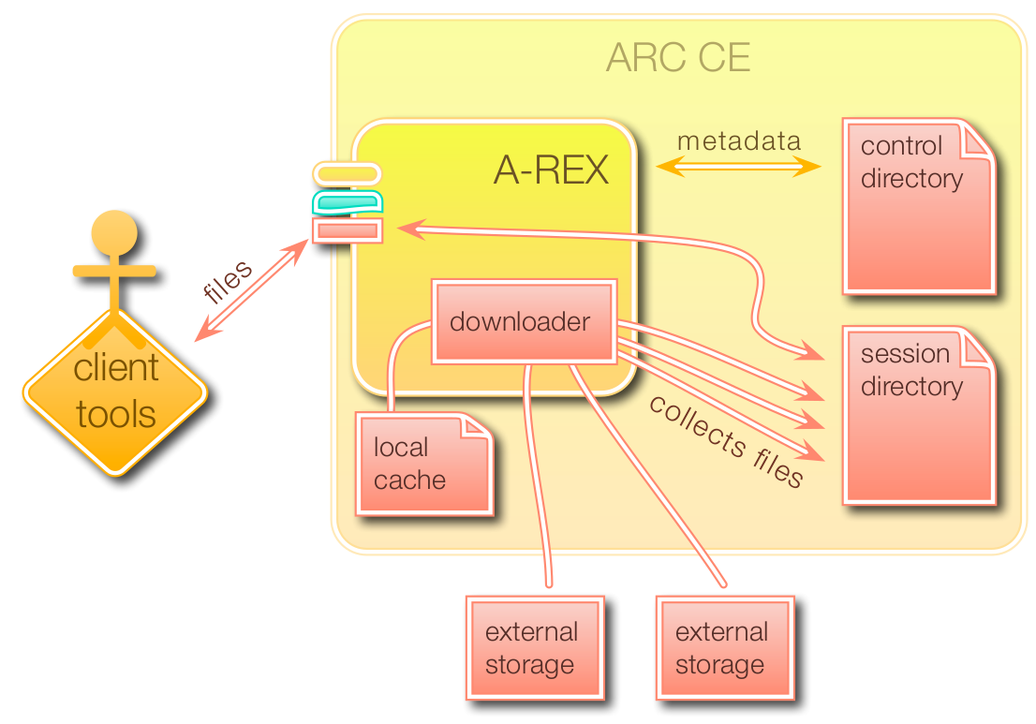
Data staging
For HPC and many Grid sites ARC CE performs the critical role of transferring input and output data for jobs
Generally copying data between a shared file system and Grid storage
ARC keeps a cache of input data on the shared file system
Jobs requiring already cached files do not need to re-download them
Cache is self-managing using LRU
Protocols:
ACIX (ARC Cache Index)
File
GridFTP
HTTP(S)
LDAP
Rucio (ATLAS data management system)
SRM (Meta-protocol for access to WLCG storage, now deprecated)
S3
Xrootd (Native protocol to access files stored in ROOT format)
LFC, dcap, rfio, ... (legacy WLCG protocols supported through gfal2 library)
Note that ARC CE does not do 3rd party transfer, all data is transferred to or from a local file system

Slide 24
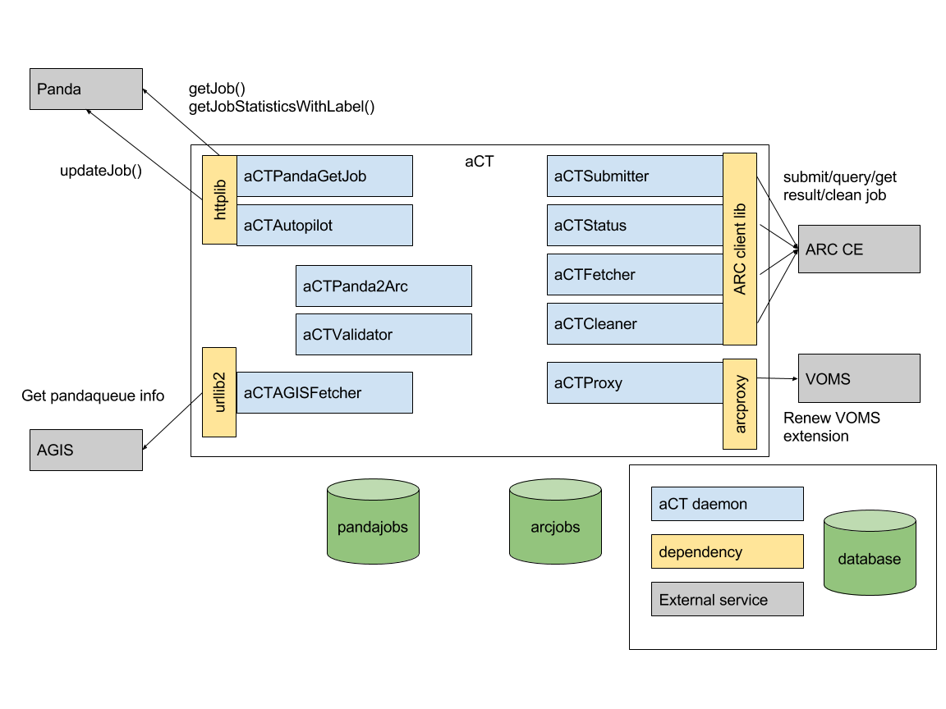
ARC Control Tower
ARC Control Tower is a meta-scheduler which manages workloads over multiple ARC CEs
Used in the ATLAS experiment as a bridge between the workload management system (Panda) and the grid sites (your own workload management system will be needed here)
Potential to add intelligent scheduling algorithms
ATLAS-facing
ARC-facing

Slide 25
UNICORE Architecture
User Workstation
UNICORE GUI
Site List
HTTP
SSL
UNICORE Server
UNICORE Server
Gateway
Gateway
SSL
Network Job Supervisor
Network Job Supervisor
Network Job Supervisor
Network Job Supervisor
Network Job Supervisor
Network Job Supervisor
TCP/IP
TCP/IP
Batchsystem
Batchsystem
Batchsystem
Batchsystem
Target System Interface
Target System Interface
Batch SubSystem
Batch SubSystem
UNICORE Site 1
UNICORE Site n

Slide 26
UNICORE Architecture
User@Workstation
UNICORE Client
X.509 User Certificate
Job Preparation Agent (JPA)
Job Monitor Controller (JMC)
Abstract jobs, status requests
Authentication
UNICORE Login
Server@Usite
optional firewall
User validation
Gateway
Site-specific authentication
optional firewall
Network Job Supervisor (NJS) (Incarnation/Scheduling)
Network Job Supervisor_{a} (NJS) (Incarnation/Scheduling)
Local user DB
Incarnation DB
Local user DB
Incarnation DB
batch jobs, status requests, data
system₁
hosts in a Vsite
system_{n}
TS Interface
TS Interface
batch subsystem_{a}
batch subsystem_{x}

Slide 28
Data management
Investigating: dCache/RDSDS

Slide 30
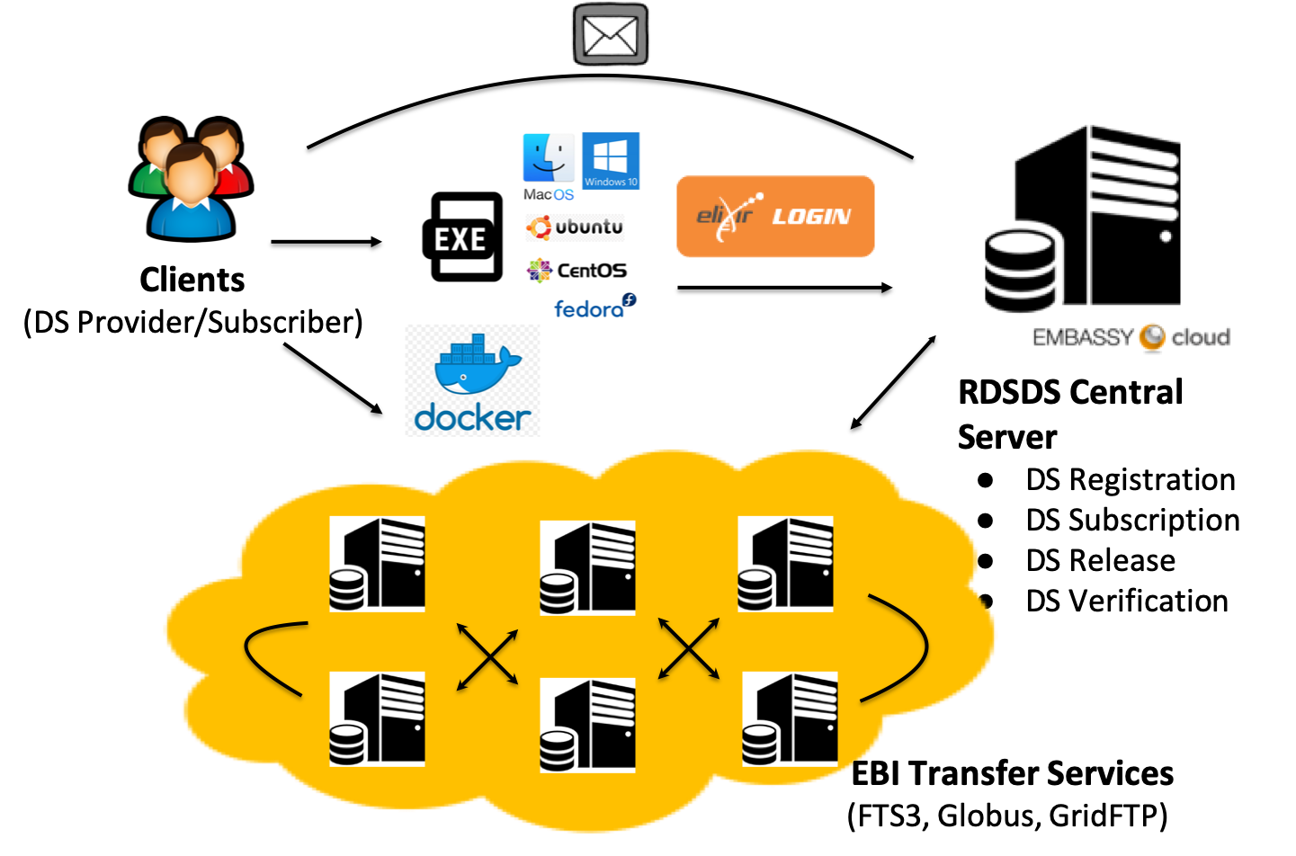
ELIXIR DRS Implementation: RDSDS

Slide 31
Use case example
Impute server

Slide 32
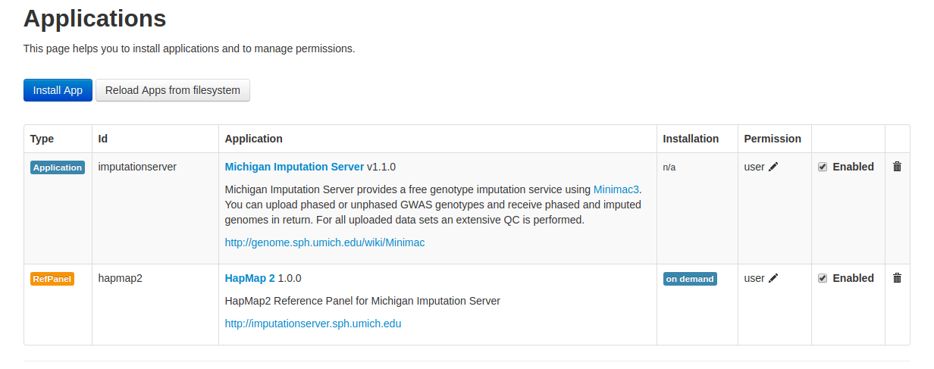
Use case 2-9 Impute server

Slide 33
Use case 2-9 Impute server
Server start command:
docker run -t -p 8081:80 -e DOCKER_CORES="16" -v $(pwd):/data/ --name imputeserver genepi/imputationserver
Benchmark start command:
docker exec -t -i imputeserver cloudgene run imputationserver --files /data/hg19-vcfs --refpanel apps@hapmap2 --conf /data/conf

Slide 34
Use case 2-9 Impute server
Input data characteristics
278MB bed file converted to one vcf.gz file per chromosome, total file size is 282MB
~1.2 million SNPs
978 individuals
1956 haplotypes

Slide 35
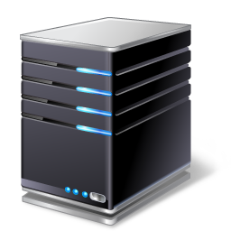
Use case 2-9 Impute server – Distributed imputation
Impute server
TSD
Federation platform
Query engine
Impute server
ePouta

Slide 36
Nordic Infrastructure service portfolio

Slide 37
EHOS: an elastic compute solution
Submitter
Master
Node
Node
Node
Node
Node
Node
uh-iaas oslo
uh-iaas Bergen

Slide 38
Socker/udocker: Secure Docker containers on HPC and MTC
Slurm
Sys Admin
Compute
Node
Compute
Node
Compute
Node
Compute
Node
Docker Engine
Docker Engine
Docker Engine
Docker Engine
Socker/udocker
runC
Pull
Docker repositories
User
-rwsr-sr-x 1 root root
Image repo
Local Registry

Slide 39
GYOC2: Get Your Own Containerized Cluster
CVMFS Repo
Reference data
container
Docker swarm
Condor
CM
container
Elastic expansion
TSD Firewall
Singularity containers
Project VLAN
Compute
container
Compute
container
Compute
container
Compute
container
Compute
container
Compute
container
Docker
Singularity
Docker
Singularity
Docker
Singularity
Docker
Singularity
Docker
Singularity
Docker
Singularity
Project storage
Sensitive data
Singularity Repo
Docker Repo
Shared Storage
bio.tools
Local
Docker Registry
Docker Images

Slide 40
Publications
Azab, Abdulrahman & Domanska, Diana Ewa (2016). Software Provisioning Inside a Secure Environment as Docker Containers Using Stroll File-System, In Rajkumar Buyya & Raul Ramos (ed.), 2016 16th IEEE/ACM International Symposium on Cluster, Cloud and Grid Computing (CCGrid). Curran Associates, Inc.. ISBN 9781509024544. Paper. s 674 - 683
Azab, Abdulrahman (2017). Enabling Docker Containers for High-Performance and Many-Task Computing, In Lisa O’Conner (ed.), 2017 IEEE International Conference on Cloud Engineering (IC2E). IEEE Computer Society. ISBN 978-1-5090-5817-4. Paper. s 279 - 285
Tekle, Kidane M; Gundersen, Sveinung; Klepper, Kjetil; Bongo, Lars Ailo; Raknes, Inge Alexander; Li, Xiaxi; Zhang, Wei; Andreetta, Christian; Mulugeta, Teshome Dagne; Kalaš, Matúš; Rye, Morten Beck; Hjerde, Erik; Antony Samy, Jeevan Karloss; Fornous, Ghislain; Azab, Abdulrahman; Våge, Dag Inge; Hovig, Eivind; Willassen, Nils Peder; Drabløs, Finn; Nygård, Ståle; Petersen, Kjell & Jonassen, Inge (2018). Norwegian e-Infrastructure for Life Sciences (NeLS). F1000 Research. ISSN 2046-1402. 7:968 . doi:10.5256/f1000research.16472.r35600
Azab, Abdulrahman; Meling, Hein; Hovig, Eivind & Pursula, Antti (2018). Stroll Filesystem Client-Server for Seamless Job Management in Sensitive Data Cloud Federation, 2018 IEEE International Conference on Big Data (Big Data).

