Slide 1
Integrating big health and big social data, to better predict heart attacks, and reduce its socioeconomic inequality
Taavi Tillmann
Associate professor
Of public health

Slide 2
A little about me
1985-1994 Estonia school
1994-2005 Manchester school
2005-2011 Glasgow medicine+psychology BScs
2011-2013 London general medical doctor
2013-2021 London public health registrar/resident doctor
2013-2017 London public health research MSc PhD
2022- Tartu public health associate professor (innovation)

Slide 3
Agenda
Why predict heart disease
What we know about socioeconomic predictors of heart disease
What is currently implemented in the real world
Our 5-15 year vision
Our 5 year project

Slide 4
Heart disease is 90% preventable
Heart disease (a.k.a cardiovascular disease) includes heart attacks and stroke. Caused by similar mechanisms. Nr 1 cause of death.
For 90% of cases, we know what caused it.
Some countries have already lowered heart disease by 80%.
You can prevent 80-90% of heart disease by more than one way:
A) Make everyone’s lifestyle behaviours perfect. (e.g. More olive oil)
B) Give high-risk people preventative drugs (e.g. Statin trials).
C) A little bit of both.

Slide 5
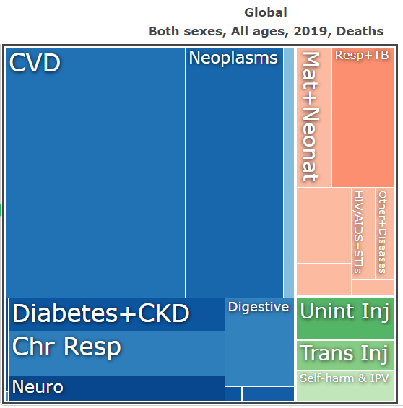
Gakidou E,… Tillmann T, Jürisson M,… et al.. Global, regional, and national comparative risk assessment of 84 behavioural, environmental and occupational, and metabolic risks or clusters of risks, 1990-2016: a systematic analysis for the Global Burden of Disease Study 2016. The Lancet. http://ihmeuw.org/5vel

Slide 6
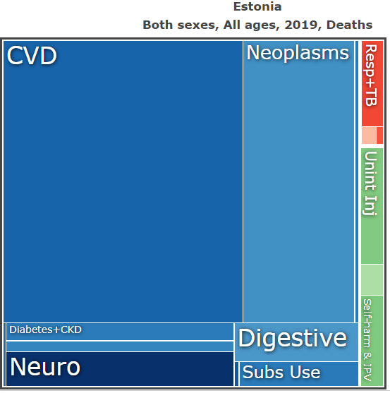
Gakidou E,… Tillmann T, Jürisson M,… et al.. Global, regional, and national comparative risk assessment of 84 behavioural, environmental and occupational, and metabolic risks or clusters of risks, 1990-2016: a systematic analysis for the Global Burden of Disease Study 2016. The Lancet. http://ihmeuw.org/5vel

Slide 7
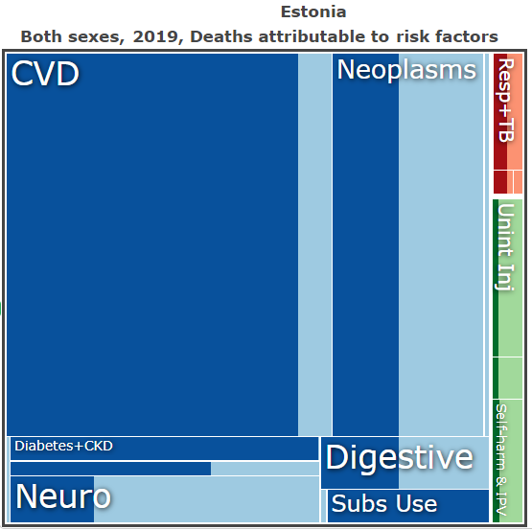
Gakidou E,… Tillmann T, Jürisson M,… et al.. Global, regional, and national comparative risk assessment of 84 behavioural, environmental and occupational, and metabolic risks or clusters of risks, 1990-2016: a systematic analysis for the Global Burden of Disease Study 2016. The Lancet. http://ihmeuw.org/5vel

Slide 8
Heart disease is 90% preventable
Heart disease (a.k.a cardiovascular disease) includes heart attacks and stroke. Caused by similar mechanisms. Nr 1 cause of death.
For 90% of cases, we know what caused it.
Some countries have already lowered heart disease by 80%.
You can prevent 80-90% of heart disease by more than one way:
A) Make everyone’s lifestyle behaviours perfect. (e.g. More olive oil)
B) Give high-risk people preventative drugs (e.g. Statin trials).
C) A little bit of both.

Slide 9
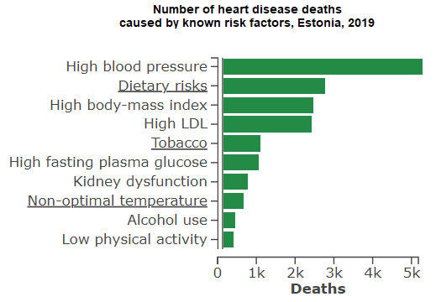
Gakidou E,… Tillmann T, Jürisson M,… et al.. Global, regional, and national comparative risk assessment of 84 behavioural, environmental and occupational, and metabolic risks or clusters of risks, 1990-2016: a systematic analysis for the Global Burden of Disease Study 2016. The Lancet. http://ihmeuw.org/5vel

Slide 10
Effective interventions:
Blood pressure medicines
Less salt, more plants
more plants
Statin medications
Stop smoking counselling / nicotine
more plants...
Gakidou E,… Tillmann T, Jürisson M,… et al.. Global, regional, and national comparative risk assessment of 84 behavioural, environmental and occupational, and metabolic risks or clusters of risks, 1990-2016: a systematic analysis for the Global Burden of Disease Study 2016. The Lancet. http://ihmeuw.org/5vel

Slide 11
Heart disease is 90% preventable
Heart disease (a.k.a cardiovascular disease) includes heart attacks and stroke. Caused by similar mechanisms. Nr 1 cause of death.
For 90% of cases, we know what caused it.
Some countries have already lowered heart disease by 80%.
You can prevent 80-90% of heart disease by more than one way:
A) Make everyone’s lifestyle behaviours perfect. (e.g. More olive oil)
B) Give high-risk people preventative drugs (e.g. Statin trials).
C) A little bit of both.

Slide 12
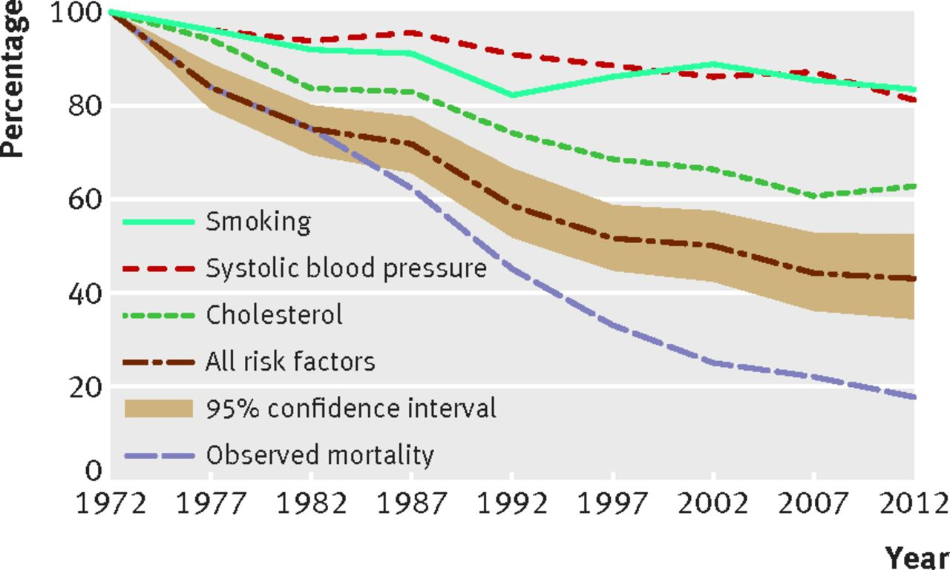
Jousilahti P, et al. Primary prevention and risk factor reduction in coronary heart disease mortality among working aged men and women in eastern Finland over 40 years: population based observational study. BMJ. 2016.

Slide 13
Heart disease is 90% preventable
Heart disease (a.k.a cardiovascular disease) includes heart attacks and stroke. Caused by similar mechanisms. Nr 1 cause of death.
For 90% of cases, we know what caused it.
Some countries have already lowered heart disease by 80%.
You can prevent 80-90% of heart disease by more than one way:
A) Make everyone’s lifestyle behaviours perfect. (e.g. More olive oil)
B) Give high-risk people preventative drugs (e.g. Statin trials).
C) A little bit of both.

Slide 14
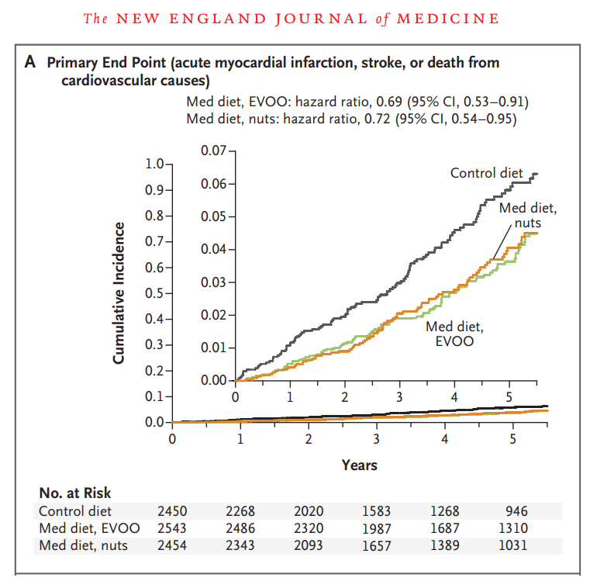
Estruch R, et al. Primary prevention of cardiovascular disease with a Mediterranean diet supplemented with extra-virgin olive oil or nuts.
New England Journal of Medicine. 2018.

Slide 15
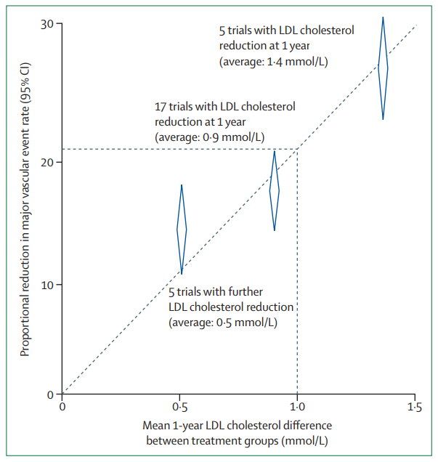
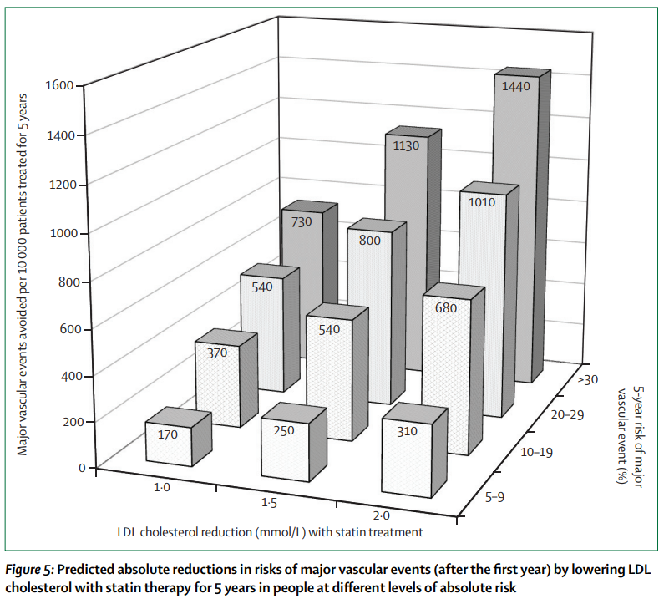
Collins R. et al. Interpretation of the evidence for the efficacy and safety of statin therapy. The Lancet. 2016.

Slide 16
Agenda
Why predict heart disease
What we know about socioeconomic predictors of heart disease
What is currently implemented in the real world
Our 5-15 year vision
Our 5 year project

Slide 17
Socioeconomic status is a leading predictor of heart disease
Socioeconomic status = Education, Occupation, Income, Wealth (housing & location).
Powerful predictors of heart disease.
Even more magnified effects in Eastern European countries (hypothesis: the stress of rapid societal transition is concentrated among the most vulnerable).
These associations are probably causal.
When adding predictors to heart disease prediction algorithms, each measure adds additive value to prediction accuracy (niche branch of sociology + clinical prediction models).

Slide 18
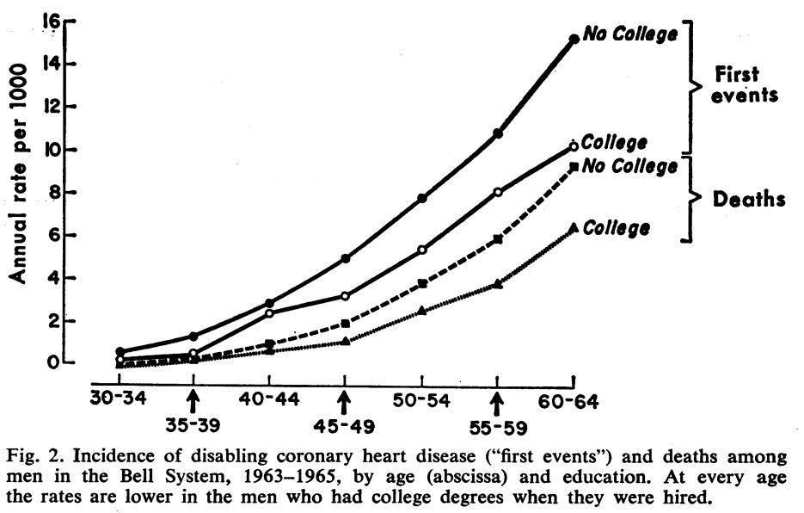
Hinkle LE. Occupation, éducation, and coronary heart disease. Risk is influenced more by education and background than by occupational experiences, in the Bell System. Science. 1968.

Slide 19
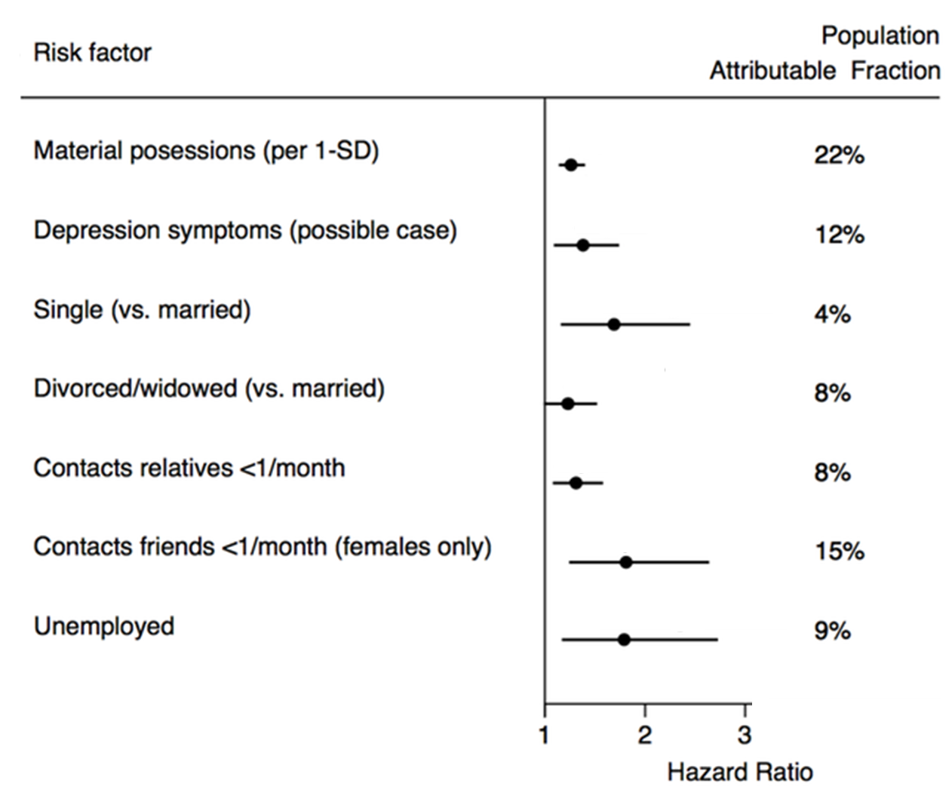
Tillmann T, Pikhart H, Peasey A, Kubinova R, Pajak A, Tamosiunas A, Malyutina S, Steptoe A, Kivimäki M, Marmot M, Bobak M. Psychosocial and socioeconomic determinants of cardiovascular mortality in Eastern Europe: A multicentre prospective cohort study. PLoS Medicine. 2017.

Slide 20
Socioeconomic status is a leading predictor of heart disease
Socioeconomic status = Education, Occupation, Income, Wealth (housing & location).
Powerful predictors of heart disease.
Even more magnified effects in Eastern European countries (hypothesis: the stress of rapid societal transition is concentrated among the most vulnerable).
These associations are probably causal.
When adding predictors to heart disease prediction algorithms, each measure adds additive value to prediction accuracy (niche branch of sociology + clinical prediction models).

Slide 21
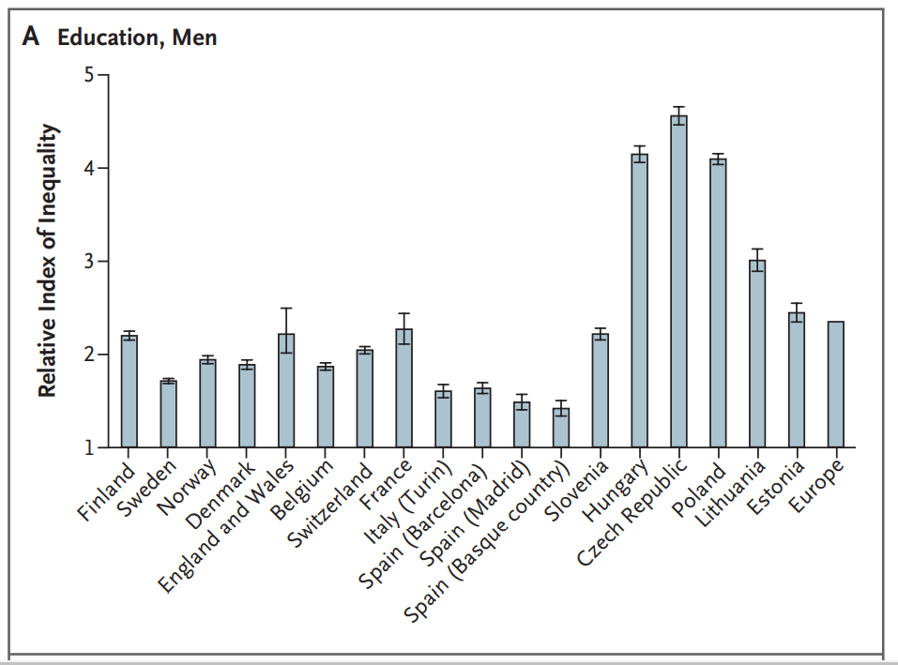
Mackenbach JP, Stirbu I, Roskam AJ, Schaap MM, Menvielle G, Leinsalu M, Kunst AE. Socioeconomic inequalities in health in 22 European countries. New England Journal of Medicine. 2008.

Slide 22
Socioeconomic status is a leading predictor of heart disease
Socioeconomic status = Education, Occupation, Income, Wealth (housing & location).
Powerful predictors of heart disease.
Even more magnified effects in Eastern European countries (hypothesis: the stress of rapid societal transition is concentrated among the most vulnerable).
These associations are probably causal.
When adding predictors to heart disease prediction algorithms, each measure adds additive value to prediction accuracy (niche branch of sociology + clinical prediction models).

Slide 23
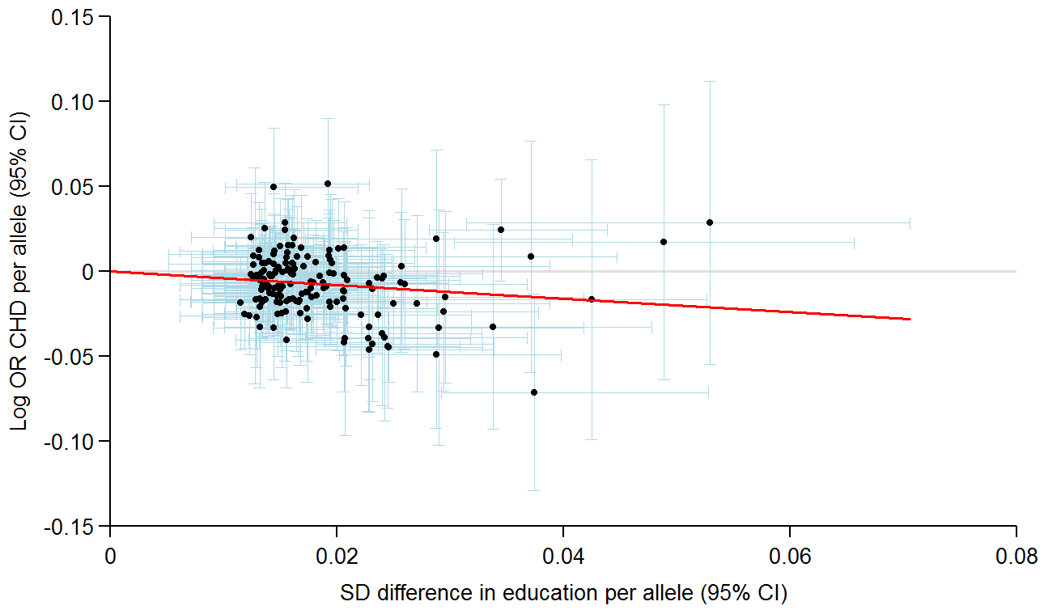
162 SNPs associated with education (x-axis) and
their associations with CHD (y-axis)
Tillmann T, Vaucher J, Okbay A, Pikhart H, Peasey A, Kubinova R, Pajak A, Tamosiunas A, Malyutina S, Fischer K, Veronesi G, Palmer T, Bowden J, Davey Smith G, Bobak M, Holmes MV. Education and coronary heart disease: a Mendelian randomization study. BMJ. 2017

Slide 24
Socioeconomic status is a leading predictor of heart disease
Socioeconomic status = Education, Occupation, Income, Wealth (housing & location).
Powerful predictors of heart disease.
Even more magnified effects in Eastern European countries (hypothesis: the stress of rapid societal transition is concentrated among the most vulnerable).
These associations are probably causal.
When adding predictors to heart disease prediction algorithms, each measure adds additive value to prediction accuracy (niche branch of sociology + clinical prediction models).

Slide 25
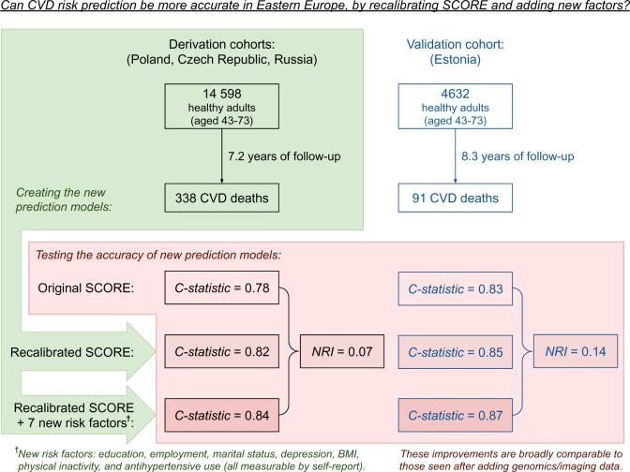
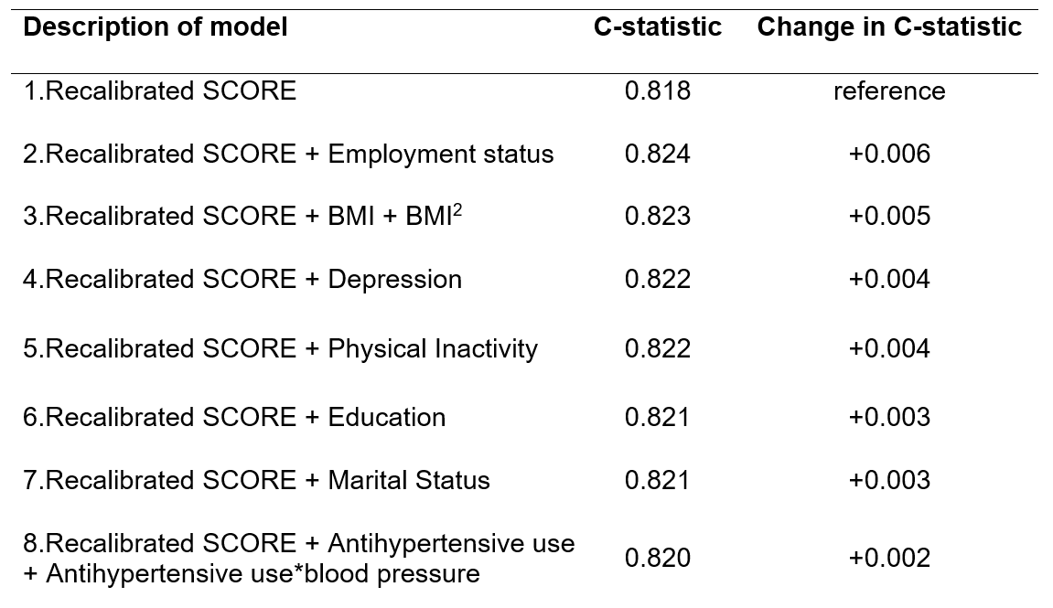
Tillmann T, Läll K, Dukes O, Veronesi G, Pikhart H, Peasey A, Kubinova R, Kozela M, Pajak A, Nikitin Y, Malyutina S. Development and validation of two SCORE-based cardiovascular risk prediction models for Eastern Europe: a multicohort study. European Heart Journal. 2020.

Slide 26
Rigorous screening services are developed in a step-by-step manner
Screening services provide a blueprint of how to design and implement a personalised preventative service:
a) Start with whole population (0-100+), exclude those already with disease.
b) Use “existing data” to exclude those with ultra-low risk (e.g. very young).
c) Invite all for simple screening tests (e.g. X-ray).
d) Have a low threshold for inviting some for invasive screening tests (e.g. biopsy).
e) Offer personalised preventative treatment (e.g. surgery, drugs).
f) Roll out in a randomised way, wait 10 years, see if people die less of disease.

Slide 27
Rigorous screening services are developed in a step-by-step manner
Heart disease screening services are under development. E.g. in the U.K.:
a) Start with whole population (0-100+), exclude those already with disease.
b) Use “existing data” to exclude those with ultra-low risk (e.g. 0-40 / eHealth data).
c) Invite all for simple screening tests (e.g. Digital self-assessment website).
d) Have a low threshold for inviting some for invasive screening tests (e.g. GP visit).
e) Offer personalised preventative treatment (e.g. statin drugs).
f) Roll out in a randomised way, wait 10 years, see if people die less of disease.

Slide 28
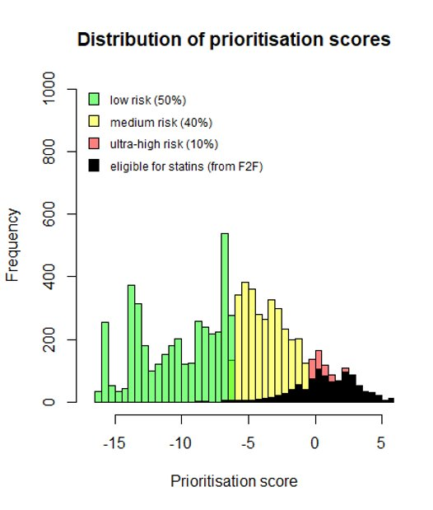
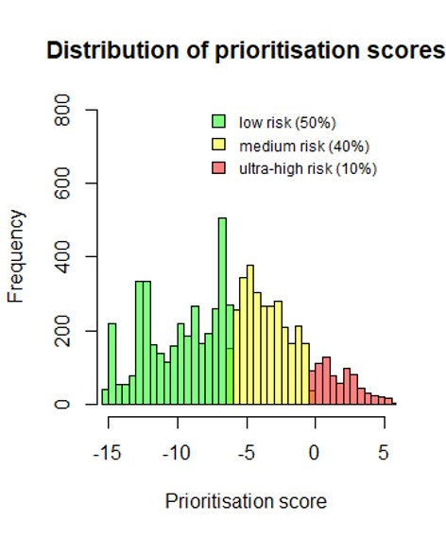

Slide 29
Rigorous screening services are developed in a step-by-step manner
Heart disease screening services are under development. E.g. in the U.K.:
a) Start with whole population (0-100+), exclude those already with disease.
b) Use “existing data” to exclude those with ultra-low risk (e.g. 0-40 / eHealth data).
c) Invite all for simple screening tests (e.g. Digital self-assessment website).
d) Have a low threshold for inviting some for invasive screening tests (e.g. GP visit).
e) Offer personalised preventative treatment (e.g. statin drugs).
f) Roll out in a randomised way, wait 10 years, see if people die less of disease.

Slide 30
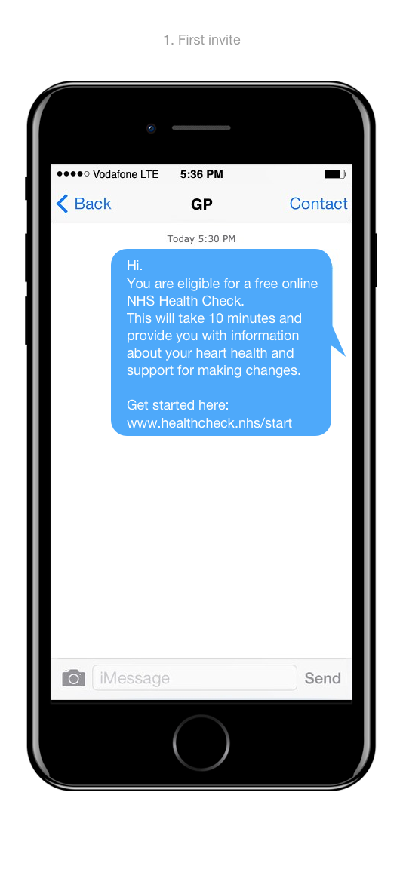
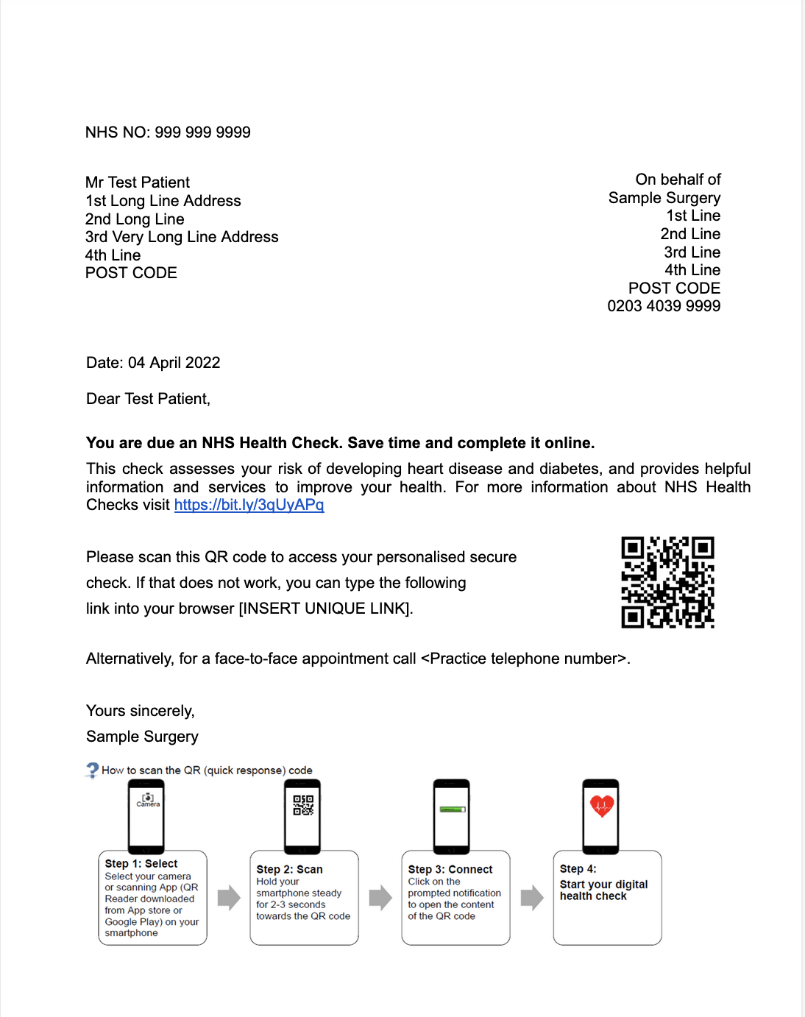

Slide 31
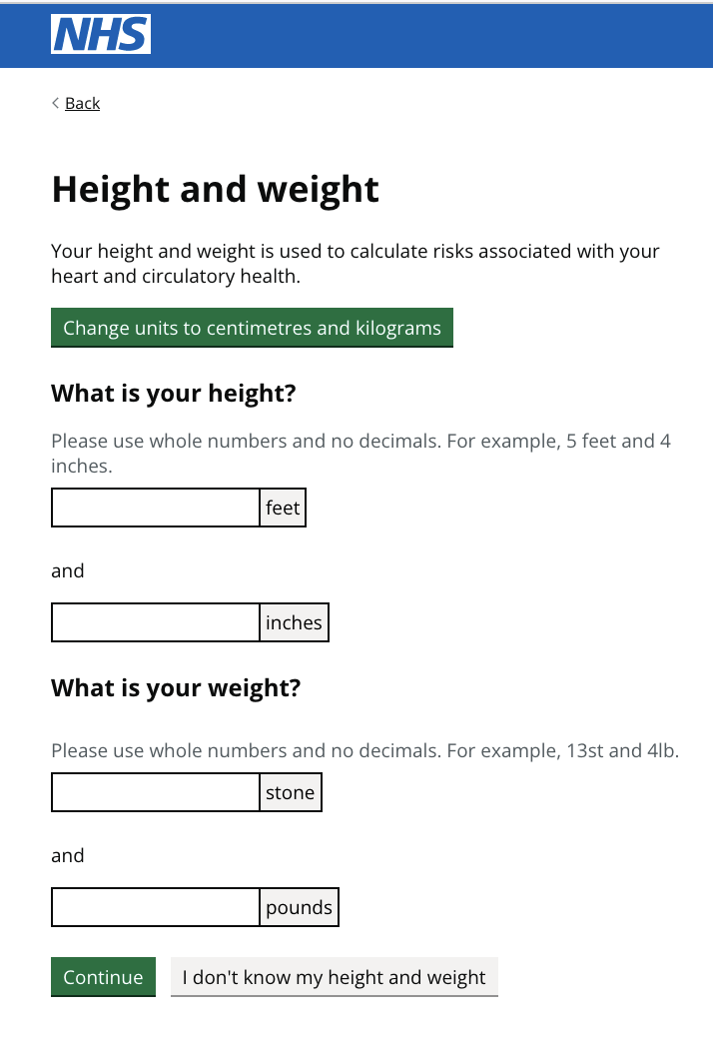
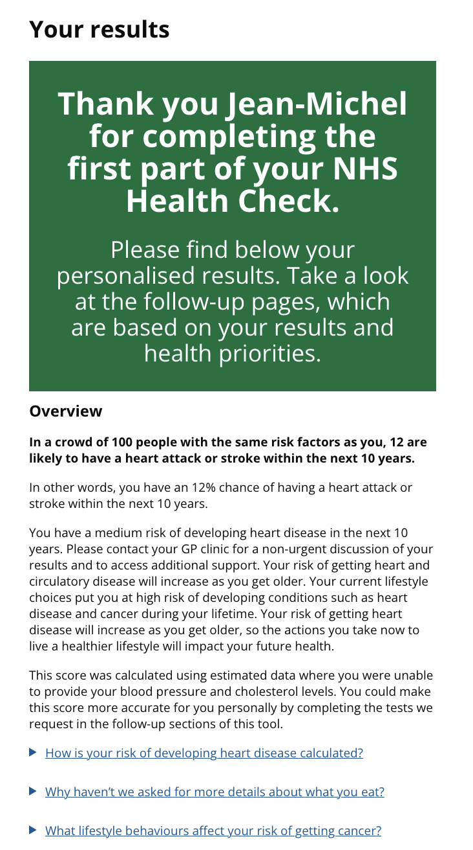
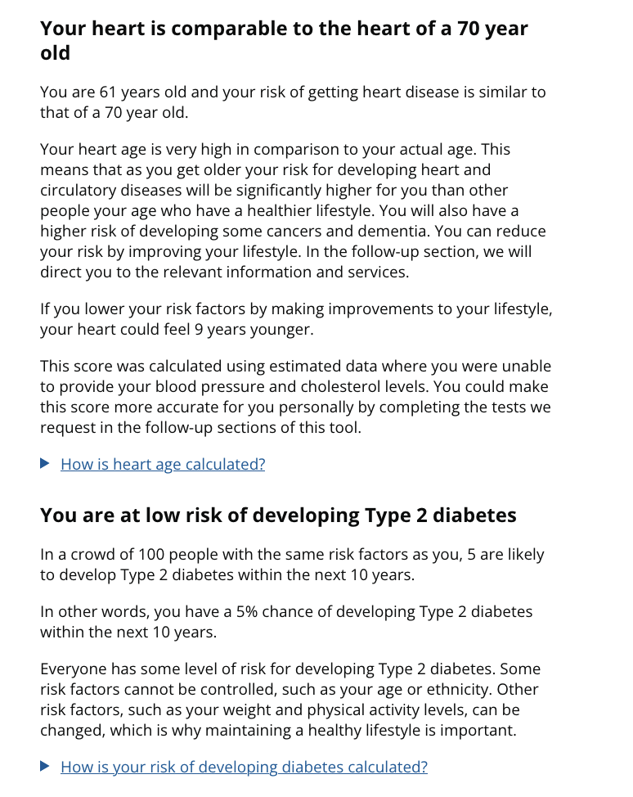
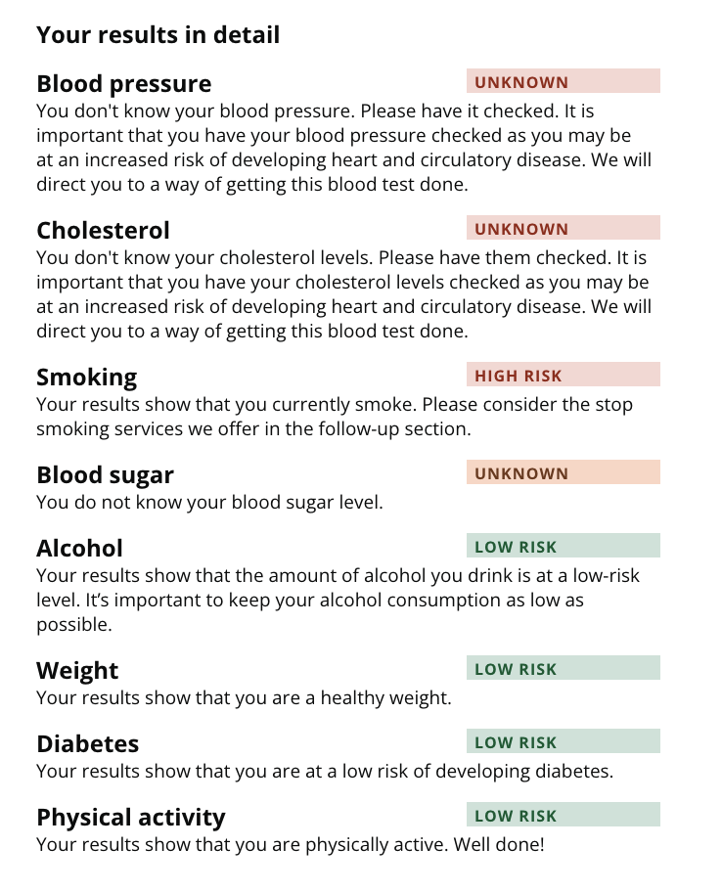
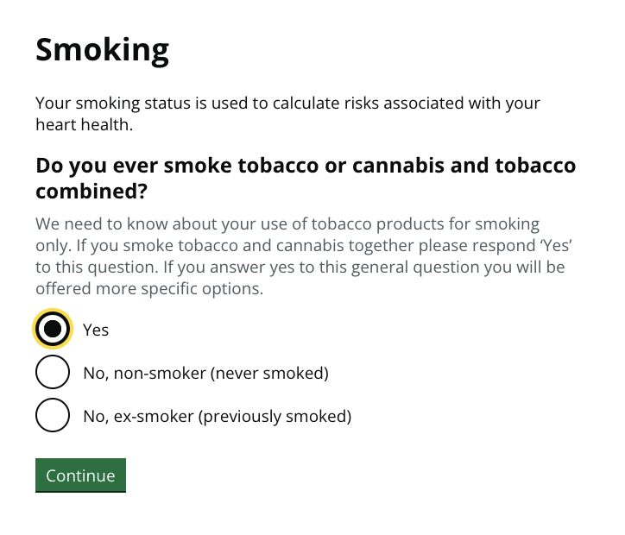

Slide 32
Rigorous screening services are developed in a step-by-step manner
Heart disease screening services are under development. E.g. in the U.K.:
a) Start with whole population (0-100+), exclude those already with disease.
b) Use “existing data” to exclude those with ultra-low risk (e.g. 0-40 / eHealth data).
c) Invite all for simple screening tests (e.g. Digital self-assessment website).
d) Have a low threshold for inviting some for invasive screening tests (e.g. GP visit).
e) Offer personalised preventative treatment (e.g. statin drugs).
f) Roll out in a randomised way, wait 10 years, see if people die less of disease.

Slide 33
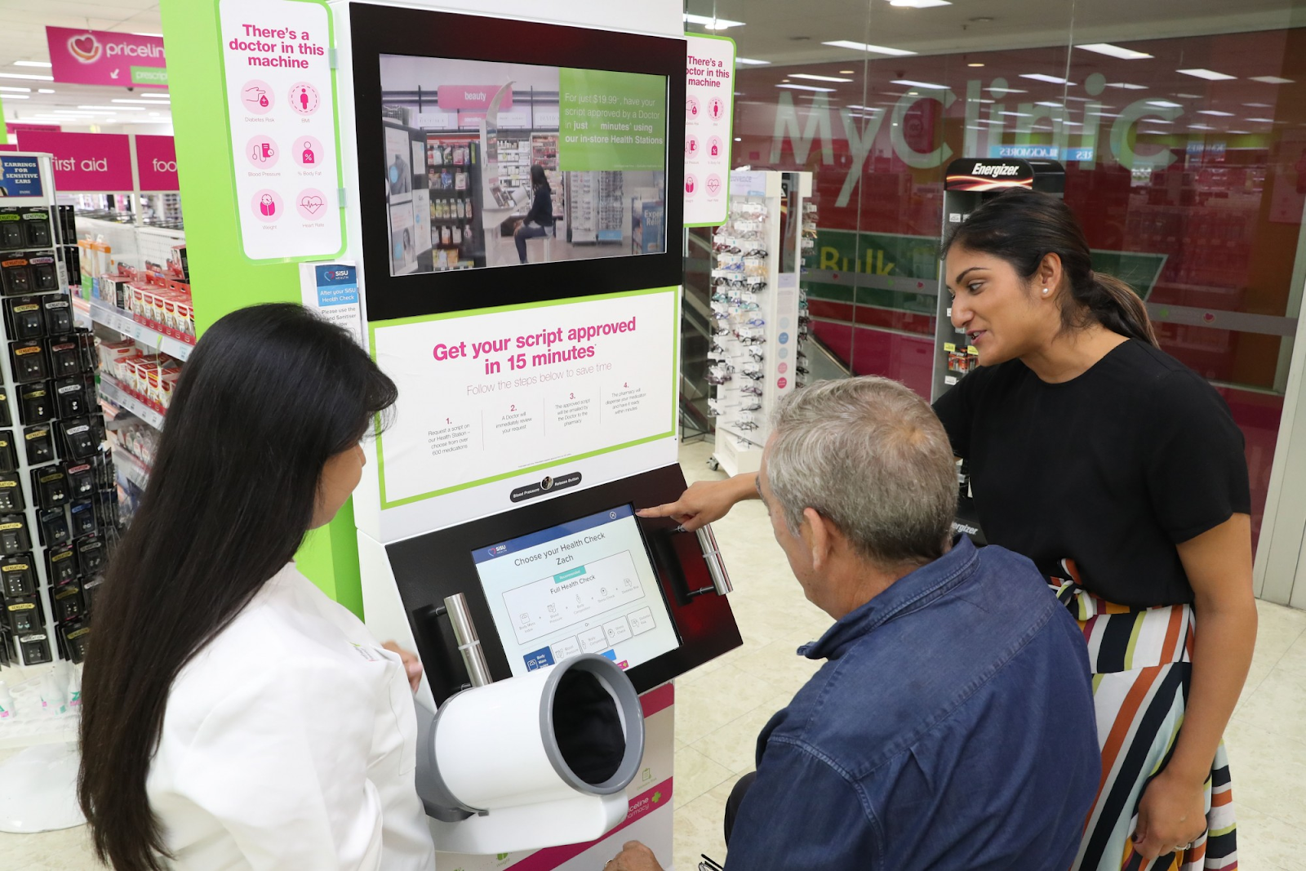
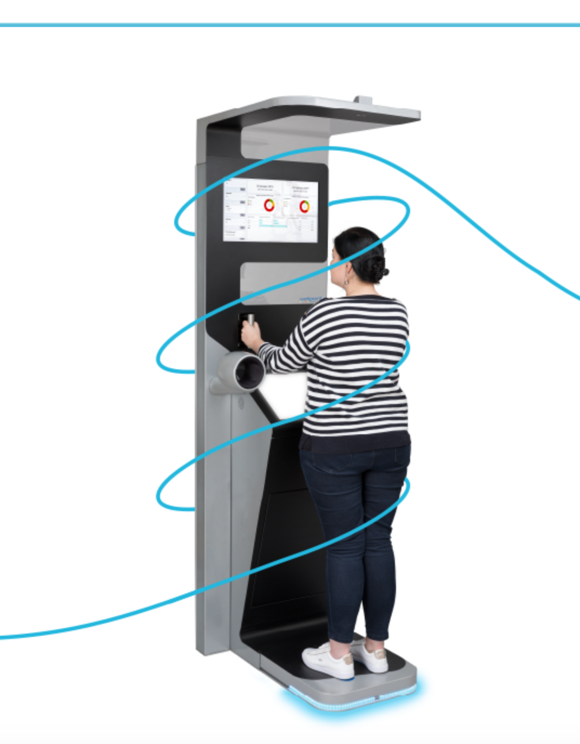

Slide 34
Rigorous screening services are developed in a step-by-step manner
Heart disease screening services are under development. E.g. in the U.K.:
a) Start with whole population (0-100+), exclude those already with disease.
b) Use “existing data” to exclude those with ultra-low risk (e.g. 0-40 / eHealth data).
c) Invite all for simple screening tests (e.g. Digital self-assessment website).
d) Have a low threshold for inviting some for invasive screening tests (e.g. GP visit).
e) Offer personalised preventative treatment (e.g. statin drugs).
f) Roll out in a randomised way, wait 10 years, see if people die less of disease.

Slide 35
Rigorous screening services are developed in a step-by-step manner
Heart disease screening services are under development. E.g. in the U.K.:
a) Start with whole population (0-100+), exclude those already with disease.
b) Use “existing data” to exclude those with ultra-low risk (e.g. 0-40 / eHealth data).
i] However, we know that this stage is increasing health inequalities.
c) Invite all for simple screening tests (e.g. Digital self-assessment website).
d) Have a low threshold for inviting some for invasive screening tests (e.g. GP visit).
e) Offer personalised preventative treatment (e.g. statin drugs).
f) Roll out in a randomised way, wait 10 years, see if people die less of disease.

Slide 36
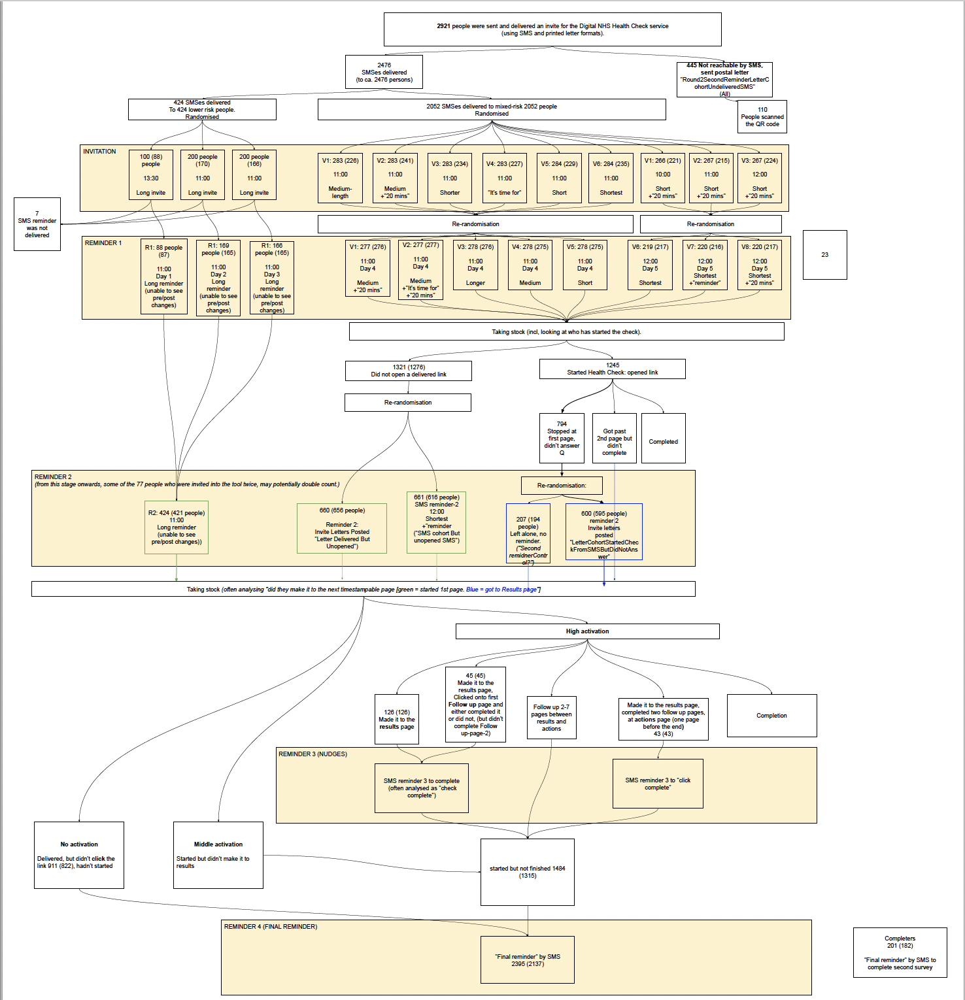
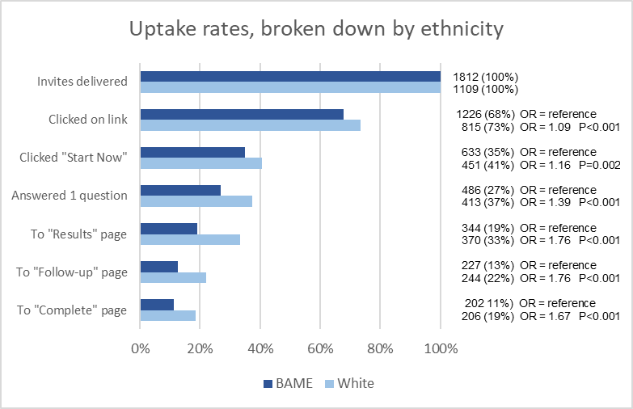

Slide 37
Rigorous screening services are developed in a step-by-step manner
Heart disease screening services are under development. E.g. most countries (Estonia):
a) Start with whole population (0-100+), exclude those already with disease.
b) Use “existing data” to exclude those with ultra-low risk (e.g. 0-40 / eHealth data).
i] However, we know that this stage is increasing health inequalities.
c) Invite all for simple screening tests (e.g. Digital self-assessment website).
d) Have a low threshold for inviting some for invasive screening tests (e.g. GP visit).
e) OPPURTUNISTICALLY offer preventative treatment (e.g. statin drugs).
f) Roll out in a randomised way, wait 10 years, see if people die less of disease.

Slide 38
Agenda
Why predict heart disease
What we know about socioeconomic predictors of heart disease
What is currently implemented in the real world
Our 5-15 year vision
Our 5 year project

Slide 39
2032: Estonia to test the world’s first heart disease screening service
Heart disease screening services are under development. E.g. most countries (Estonia):
a) Start with whole population (0-100+), exclude those already with disease.
b) Use “existing data” to exclude those with ultra-low risk (e.g. 0-40 / eHealth data).
i] However, we know that this stage is increasing health inequalities.
c) Invite all for simple screening tests (e.g. Digital self-assessment website).
d) Have a low threshold for inviting some for invasive screening tests (e.g. GP visit).
e) Offer personalised preventative treatment (e.g. statin drugs).
f) Roll out in a randomised way, wait 10 years, see if people die less of disease.

Slide 40
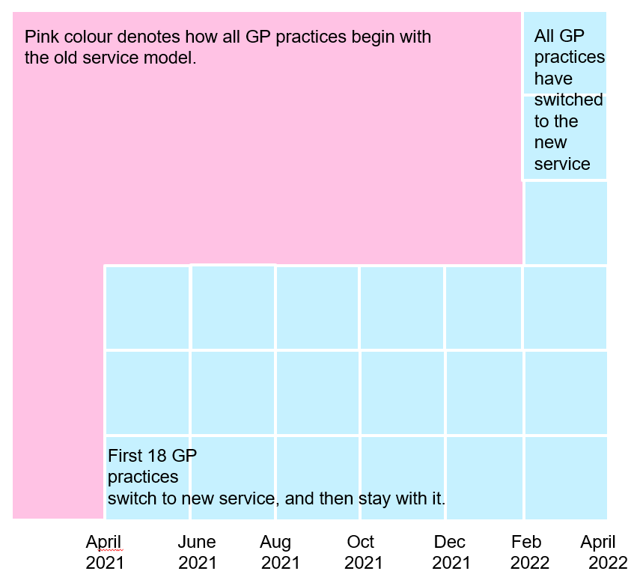

Slide 41
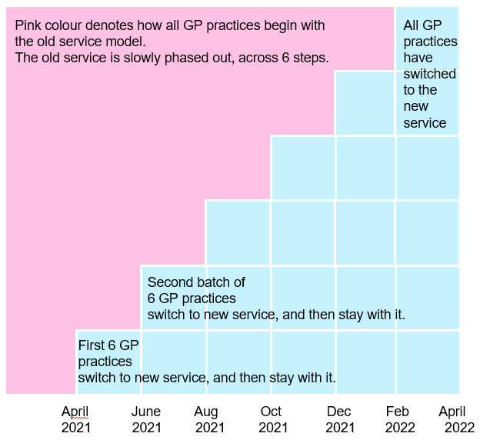

Slide 42
Agenda
Why predict heart disease
What we know about socioeconomic predictors of heart disease
What is currently implemented in the real world
Our 5-15 year vision
Our 5 year project

Slide 43
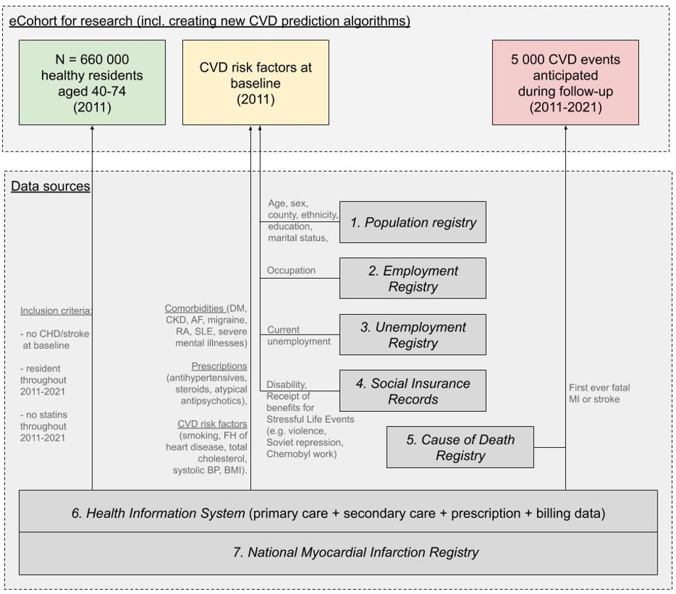
5 year project: to mine eHealth and eSocial data, and derive inequality-reducing disease prediction algorithms
OBJECTIVES: 1) To create a completely representative e-cohort (where n=all) using existing health and socio-economic data. 2) To create a new cardiovascular disease (CVD) risk prediction algorithm.
METHODS: 1) Get ethical permission (EBIN).
2) TEHIK to link identifiable data across eHealth+eSocial+Biobank datasets. Anonymize. Release to University HPC.
3) Impute missing values. (Within biobank, check accuracy).
4) Assess if these predictors predict heart disease.
5) Derive algorithm(s) [parametric/ML]. Measure inequality. Validate temporally (1-year lag) & externally (biobank).

Slide 44
5 year project: to mine eHealth and eSocial data, and derive inequality-reducing disease prediction algorithms
OBJECTIVES: 1) To create a completely representative e-cohort (where n=all) using existing health and socio-economic data. 2) To create a new cardiovascular disease (CVD) risk prediction algorithm.
EFFECTS: 1) A rich database for future research. 2) New medical device. 3) An illustration of how to reduce social inequalities when social factors are integrated into product/service development.

Slide 45
I welcome all questions, suggestions and offers to collaborate: taavi.tillmann@ut.ee

